Slide 1
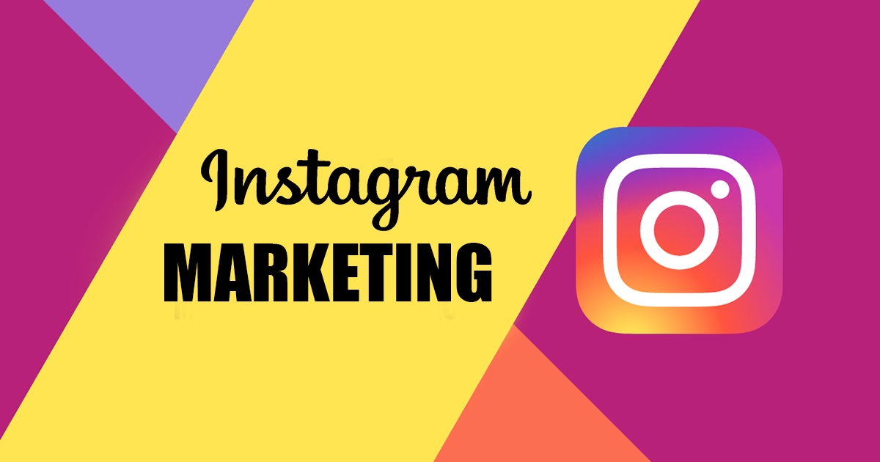
INSTAGRAM Marketing

Slide 2

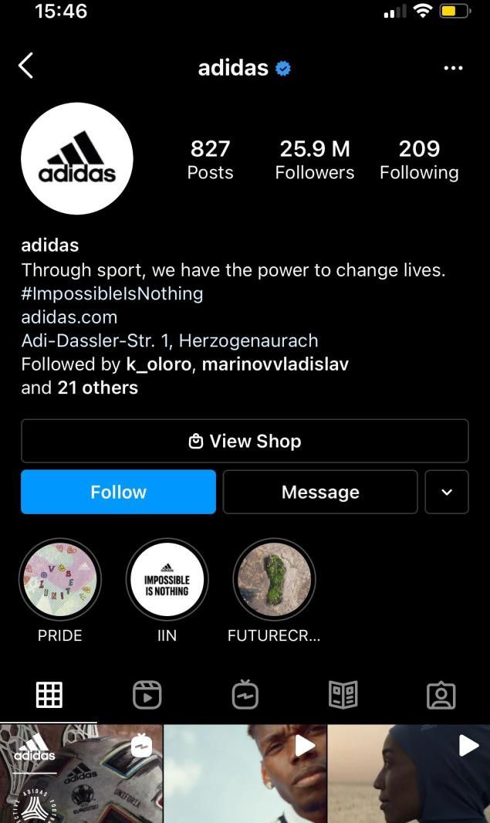
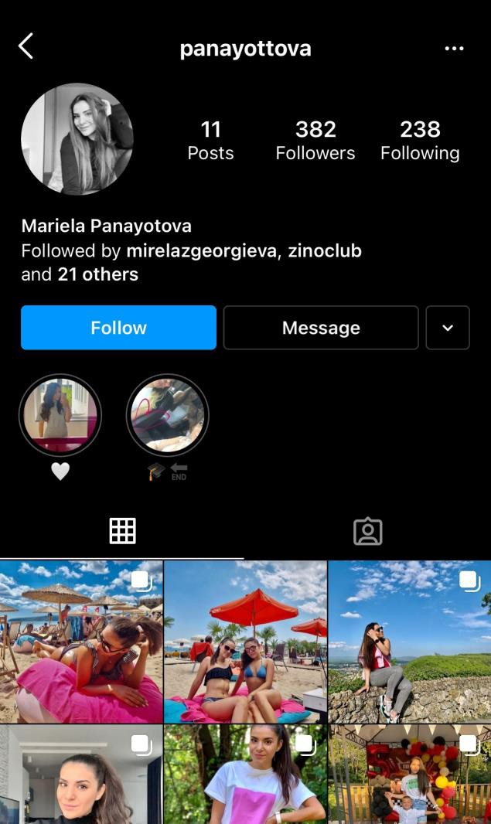







Business vs Personal Profile
A business profile has:
Instagram Insights
Address
Contact Button
Category
Advertising

Slide 3

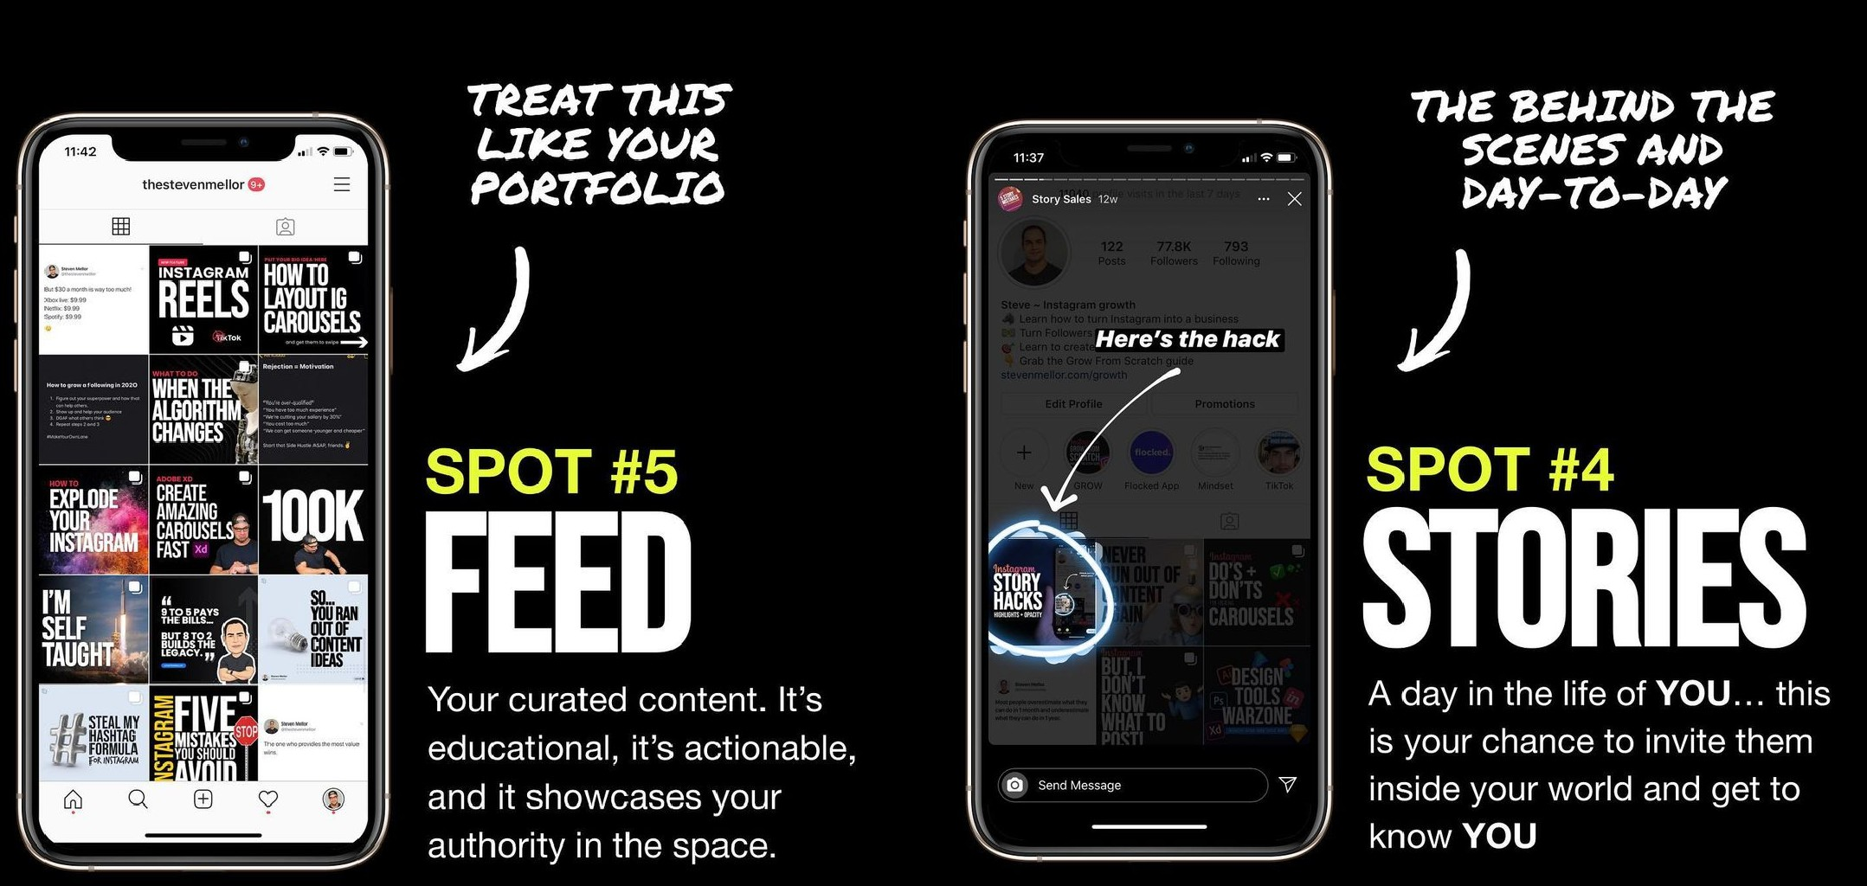
5 Places to Show Regularly
Contents

Slide 4
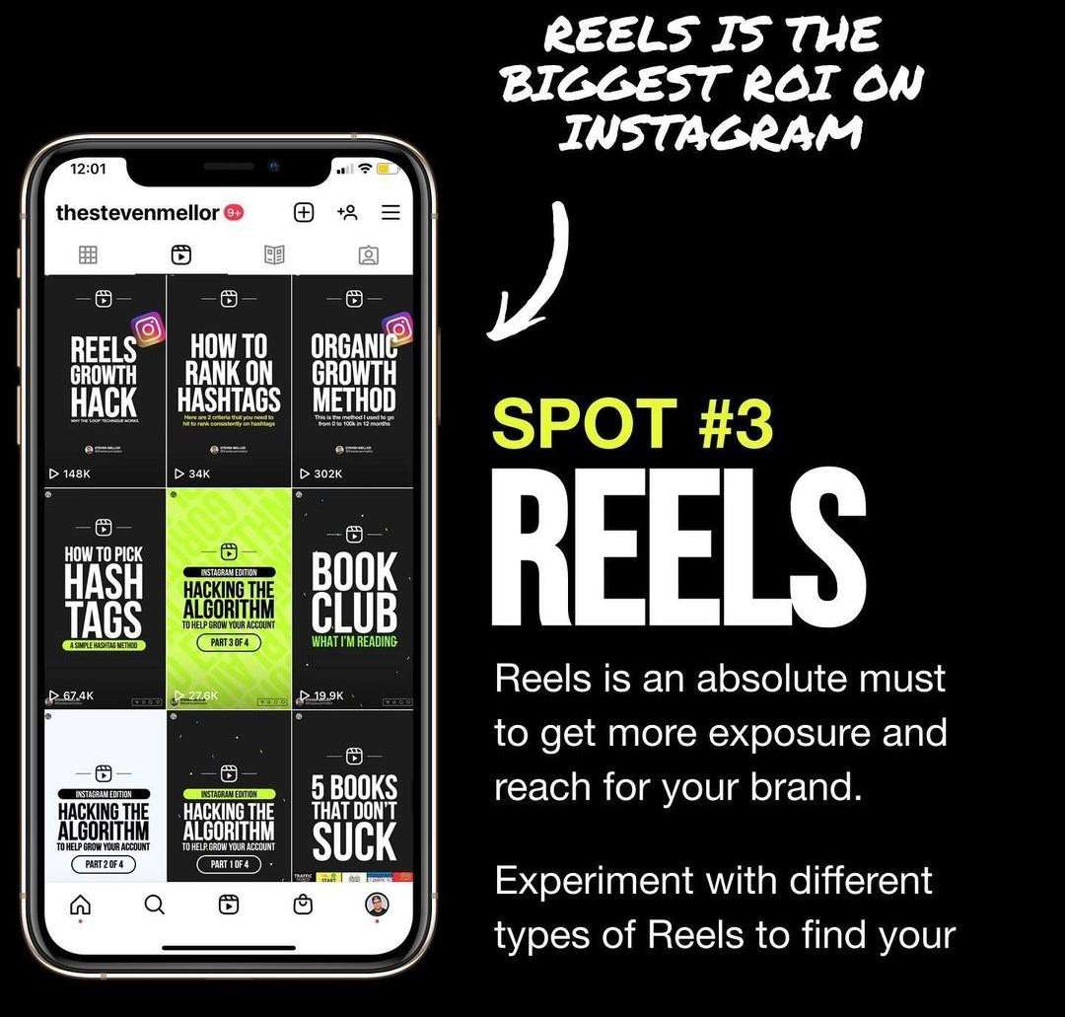
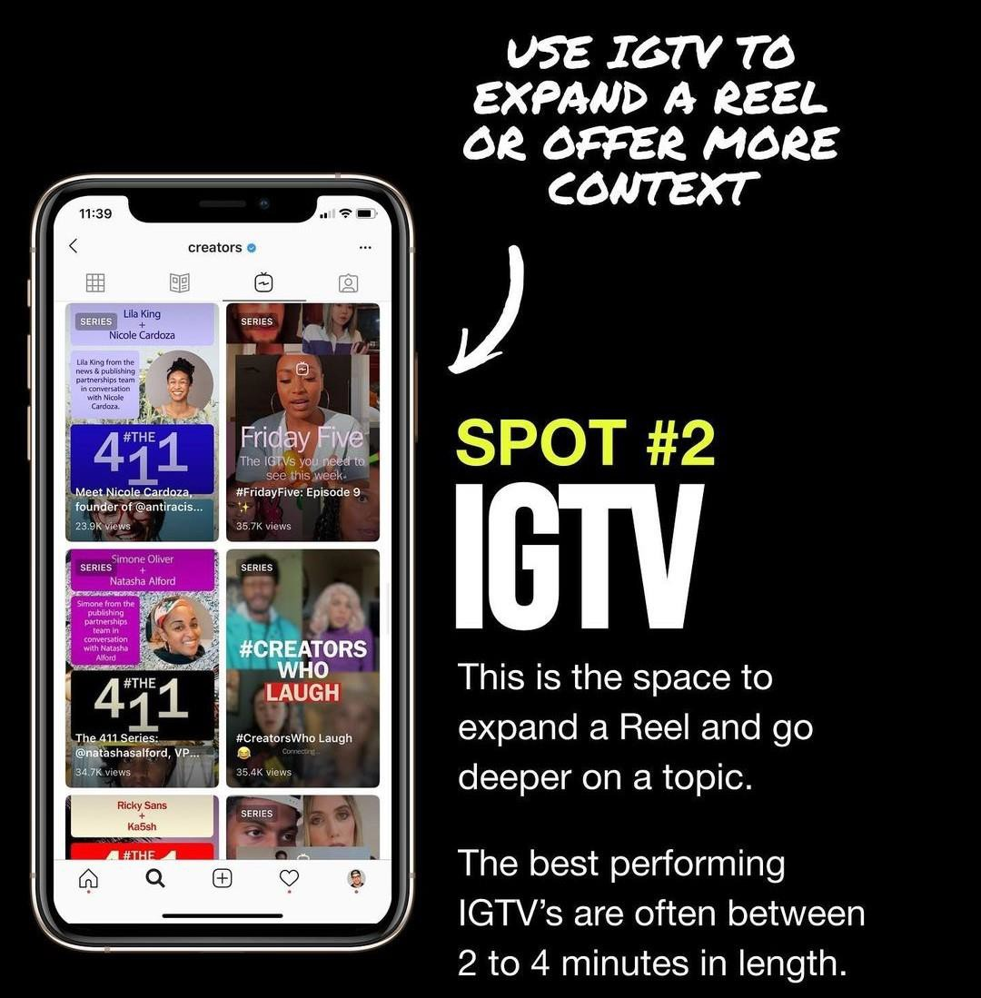
5 Places to Show Regularly
t
Con

Slide 5
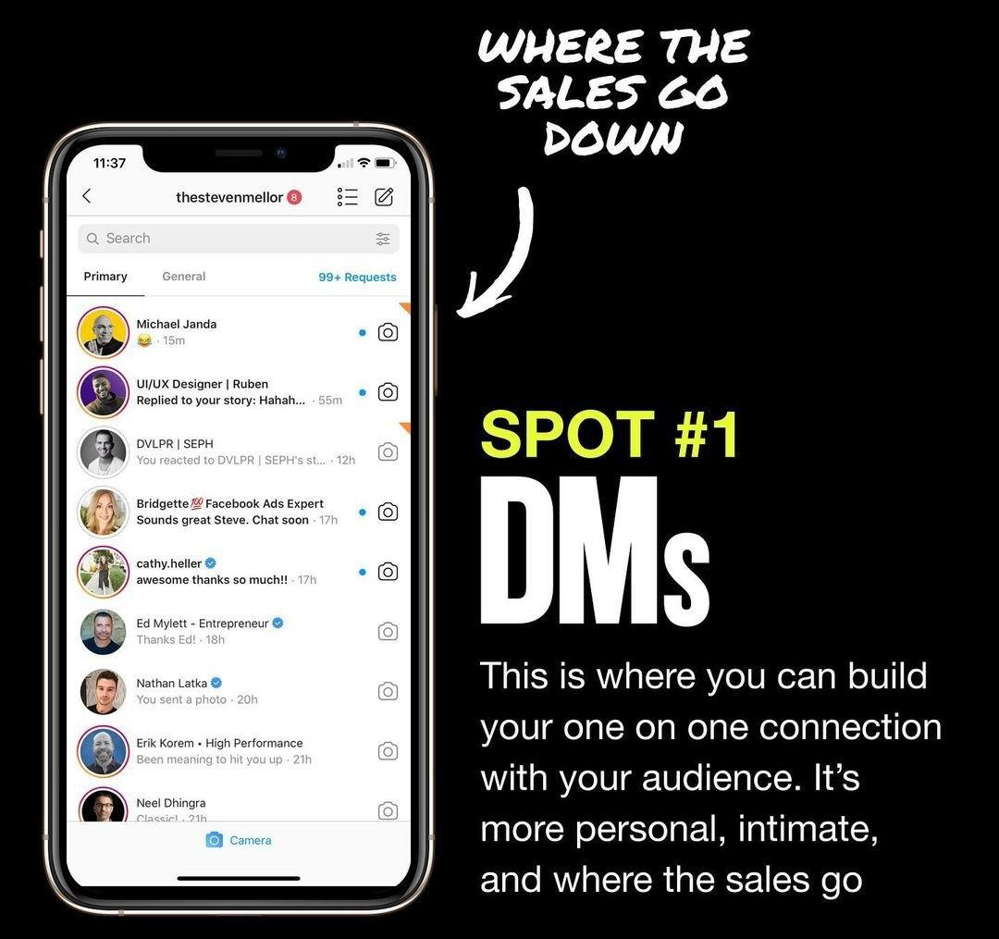
5 Places to Show Regularly
t

Slide 6
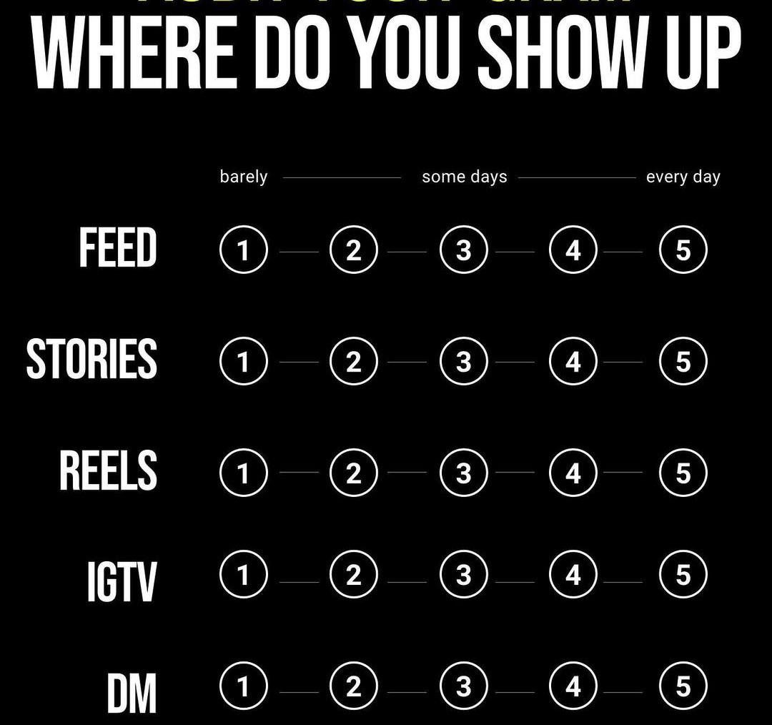
5 Places to Show Regularly

Slide 7
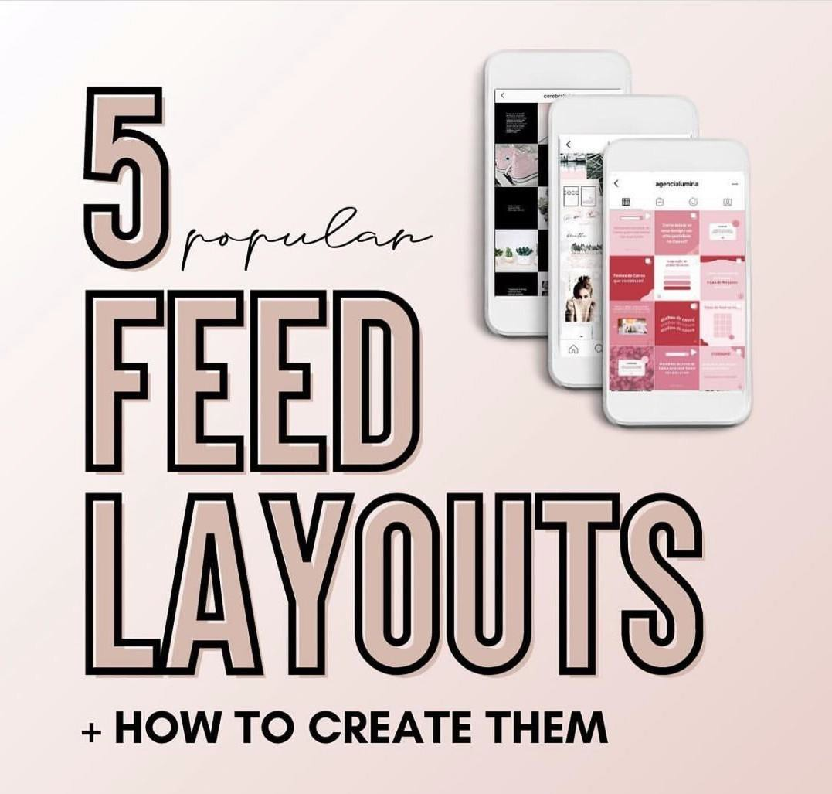
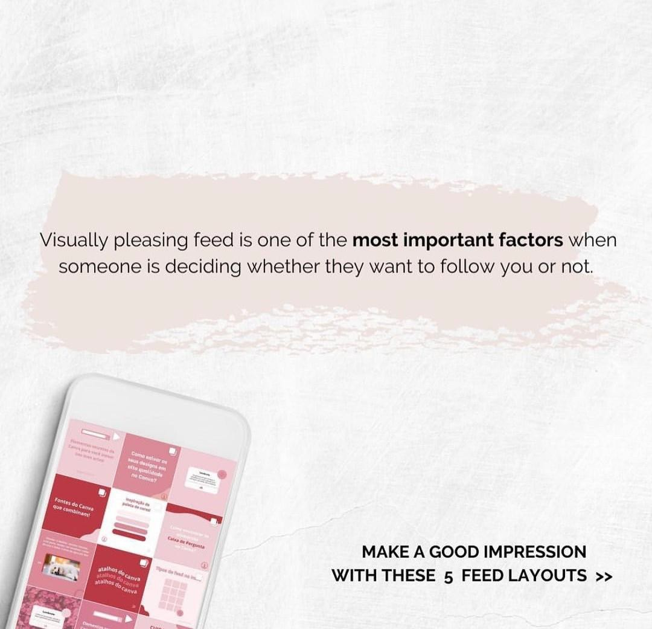
Feed Layouts + How to Create Them

Slide 8
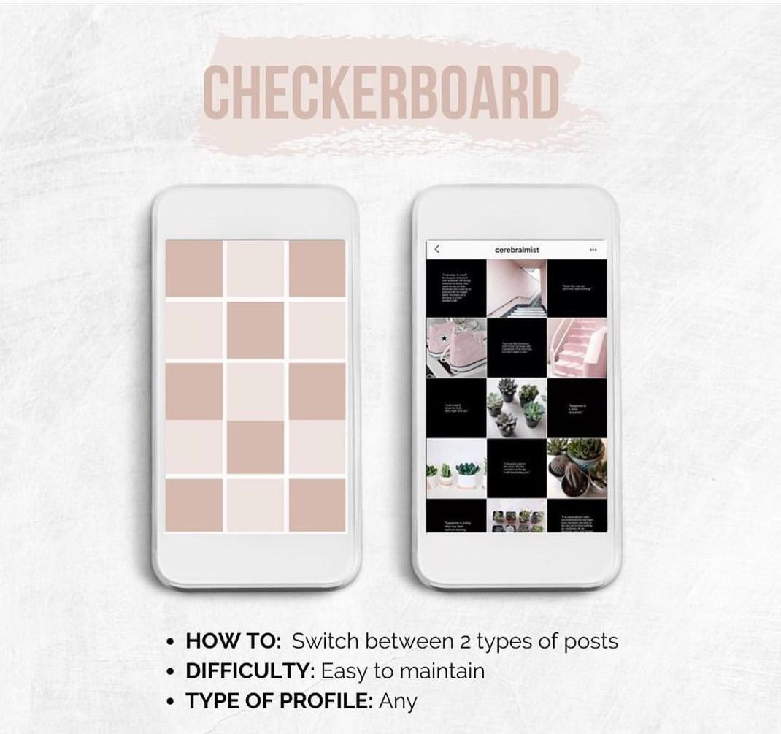
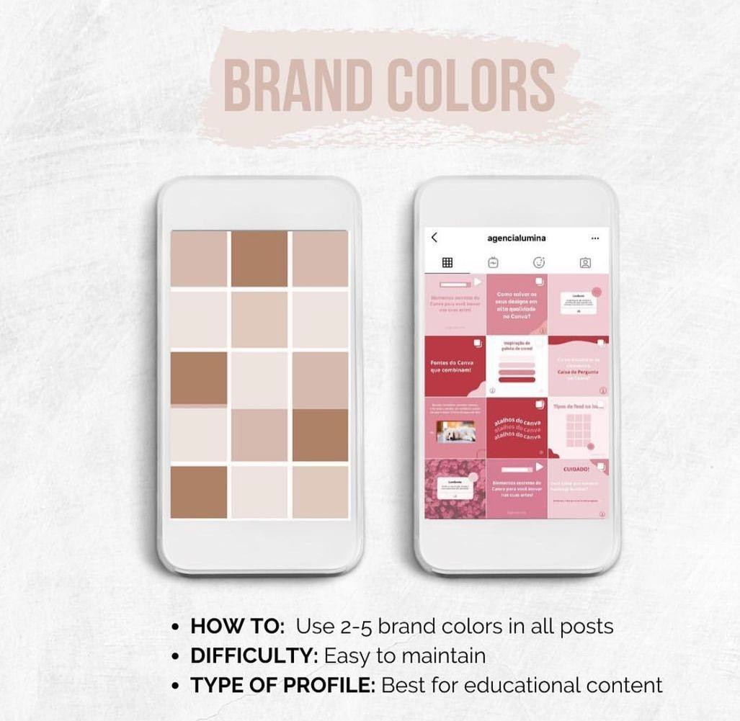
Feed Layouts + How to Create Them

Slide 9
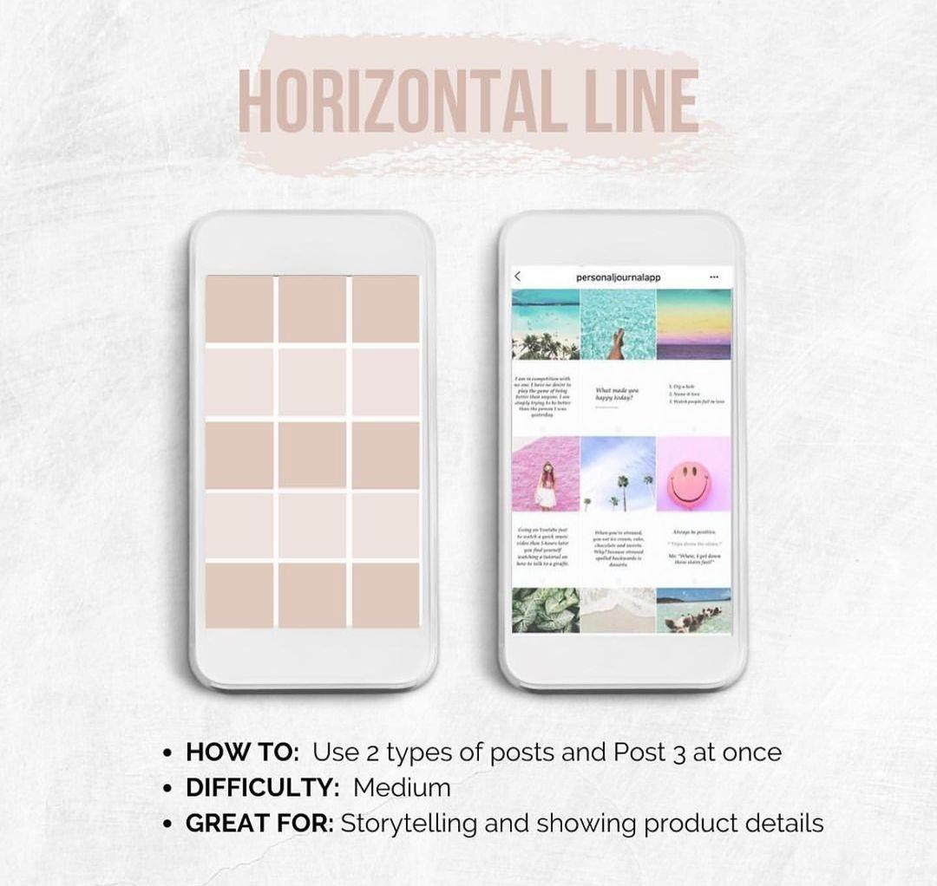
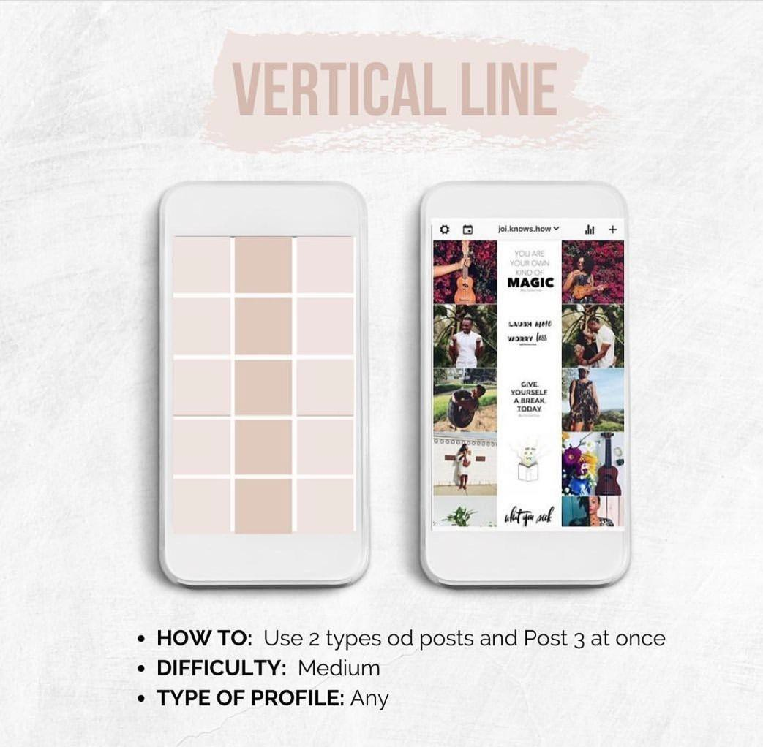
Feed Layouts + How to Create Them

Slide 10
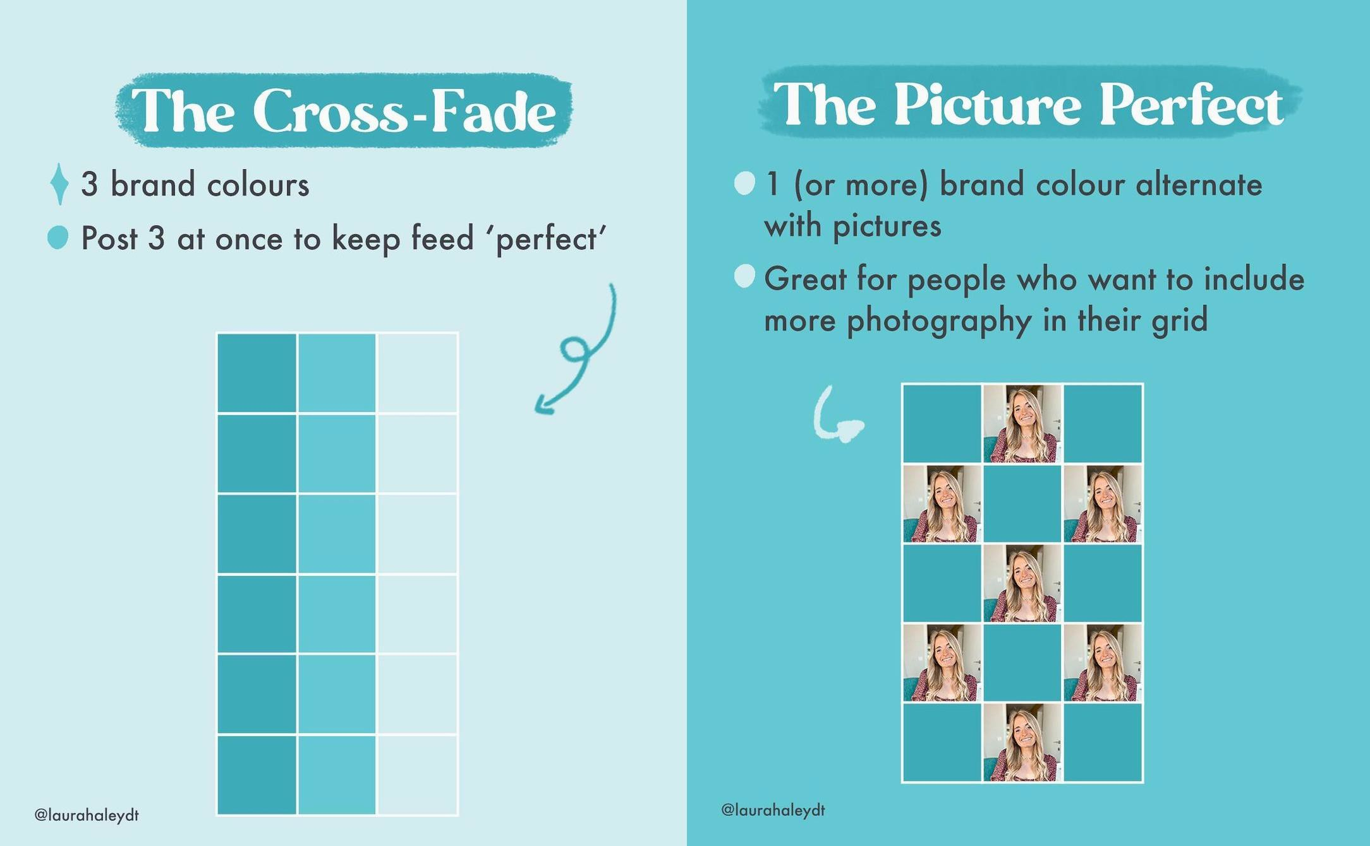
Feed Layouts + How to Create Them

Slide 11

Homework
List 3 IG accounts which you follow and explain why you follow them. What do you like more in their profiles? Is it well structured? What type of content do they post?

Slide 12
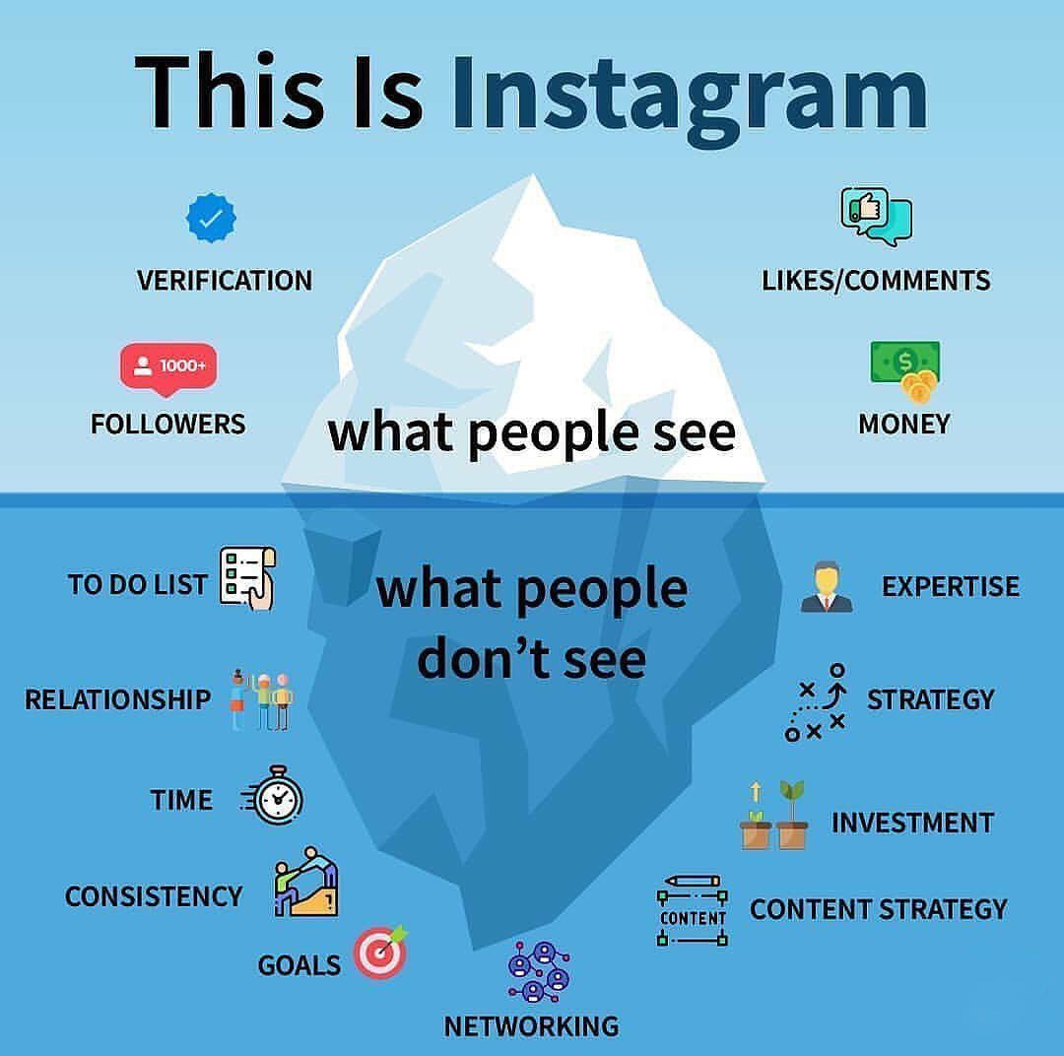
What people see…
What people see…
4

Slide 13

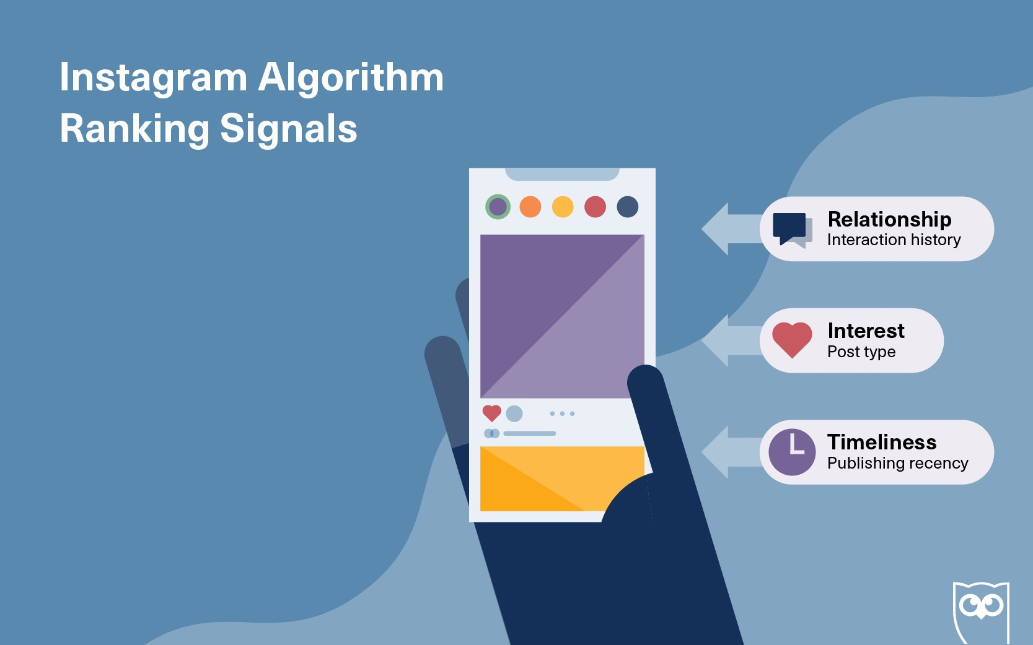
Ranking Signals
The accounts you regularly interact with
How much Instagram predicts
you’ll care about a post
How recent the posts are

Slide 14
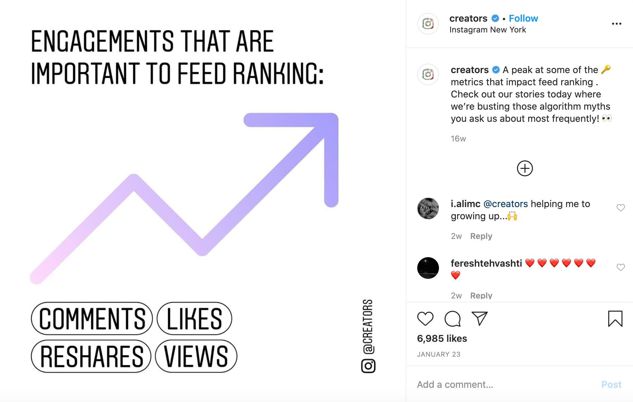
Feed Ranking

Slide 15
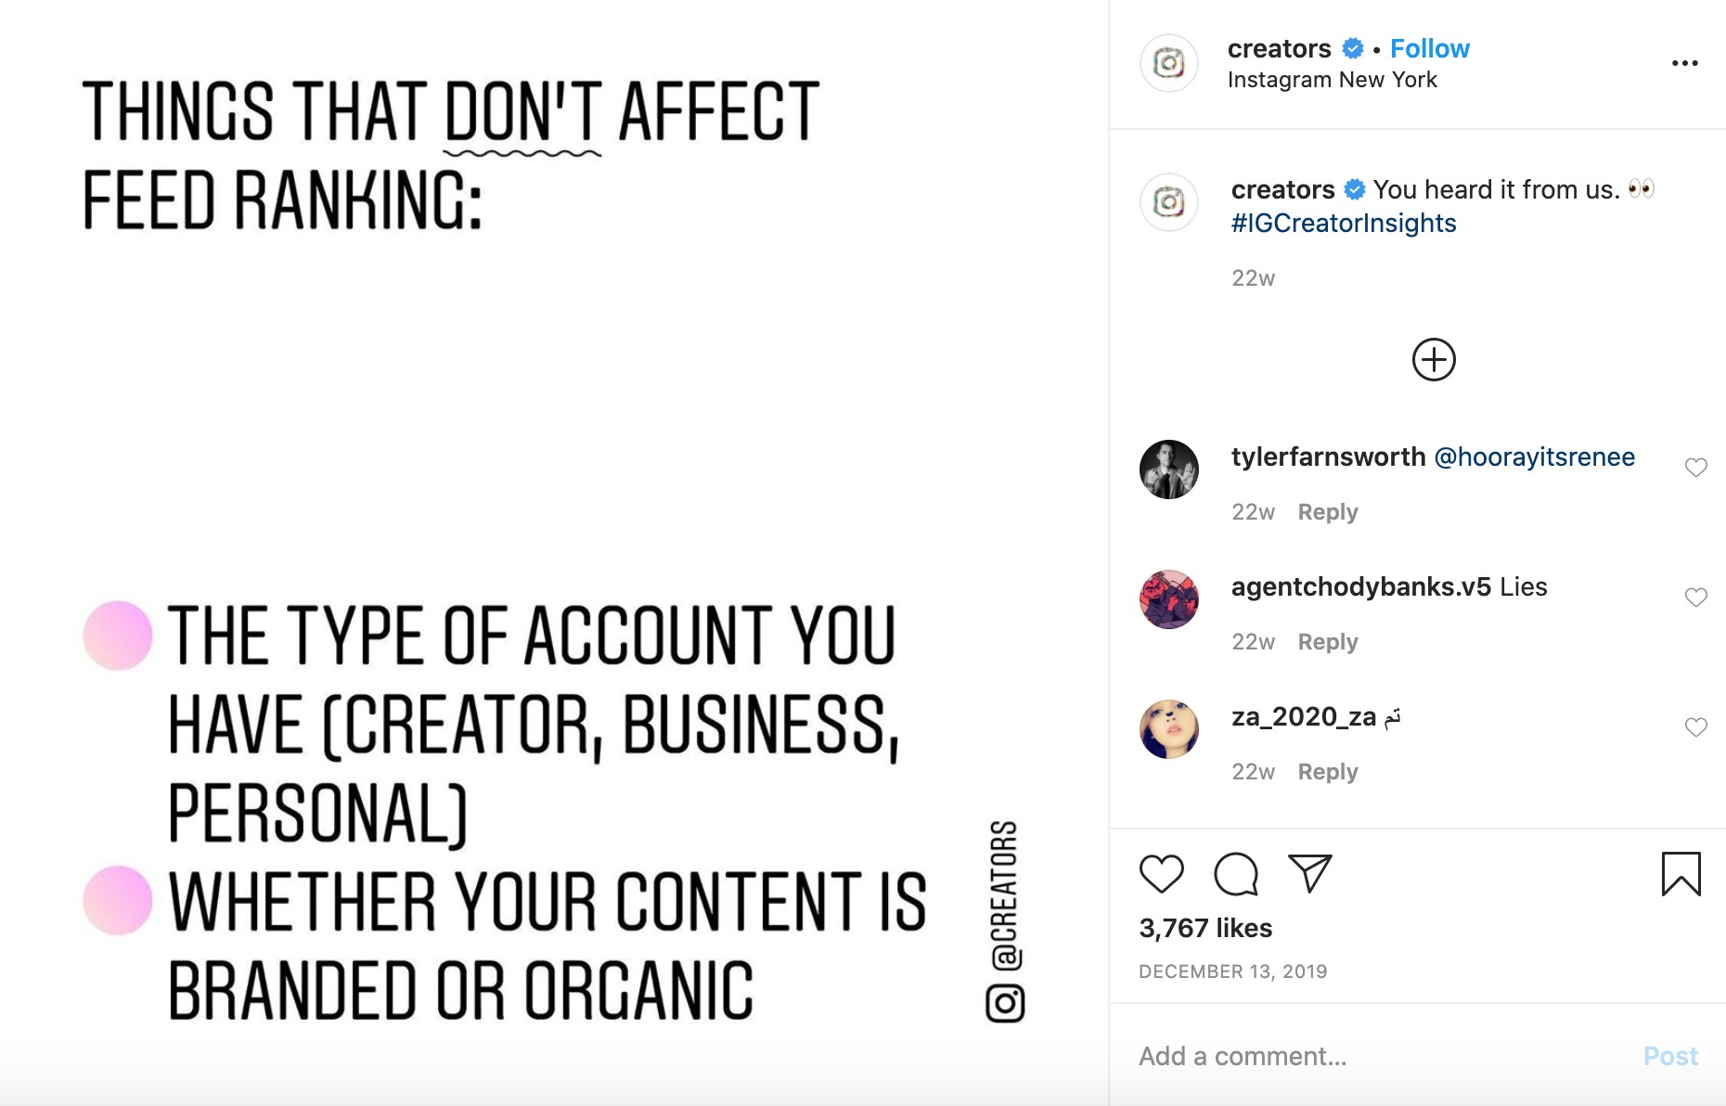
Feed Ranking

Slide 16
How the Algorithm Works
How to take advantage:
Post something people engage with (likes, saves)
Don’t do forbidden things (eg. spam, misinformation)
Stay in context (pick one niche)
Add something new to reduce the penalty score
Post more frequently (engagement teaches the algorithm)

Slide 17
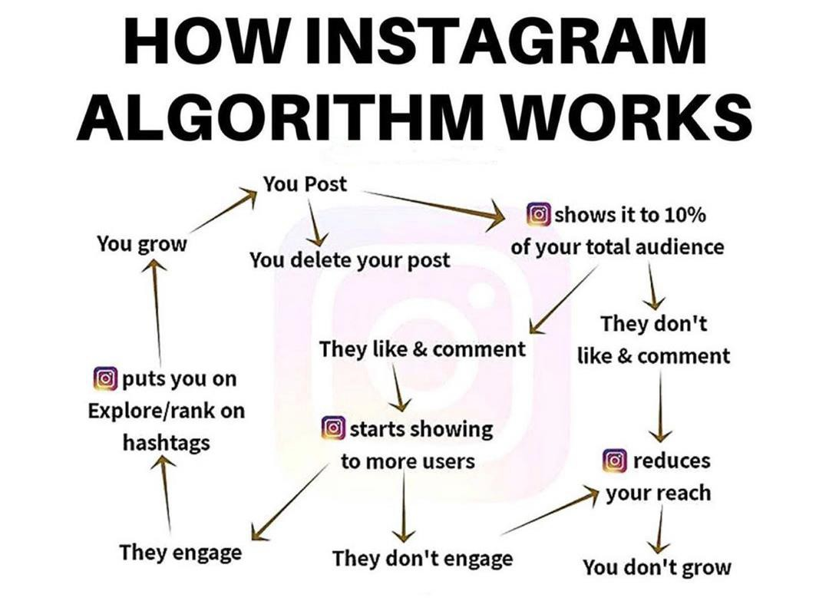
Recap

Slide 18
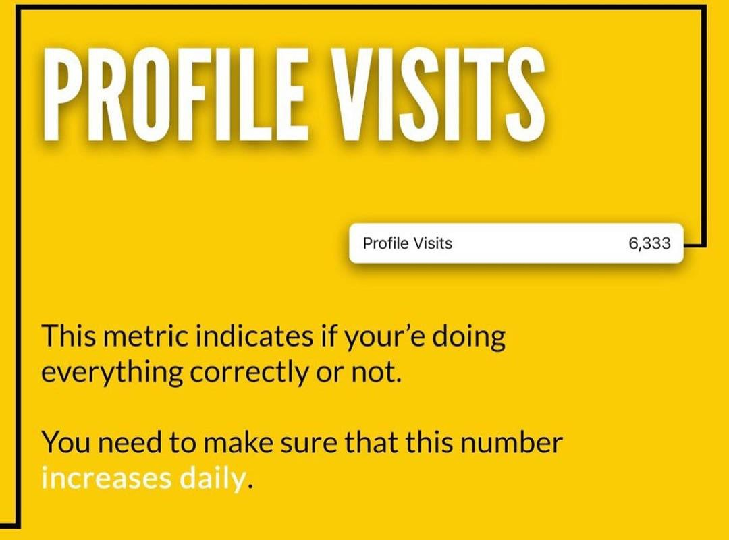
The Most Important Metric
In order to increase your profile visits, you’ll need:
To post every day
Increase your reach and impressions
by using the right hashtags
by ranking on the explore page
by posting when your followers are most
active
by making sure your posts are shareable

Slide 19
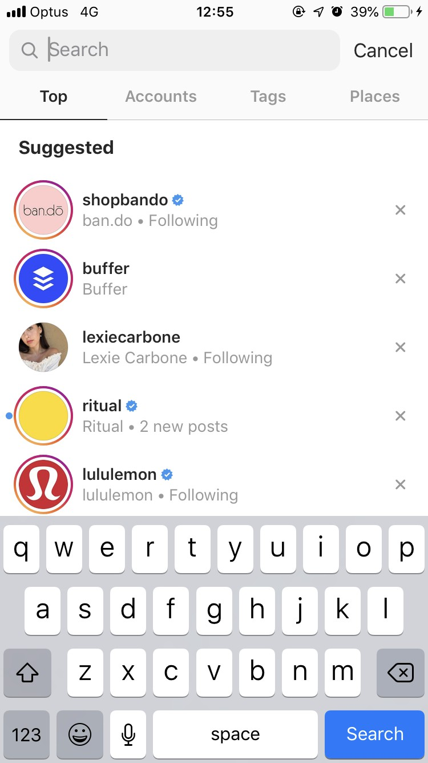
Instagram Search
How it works:
Your text in search
Your activity
Information about the search results

Slide 20
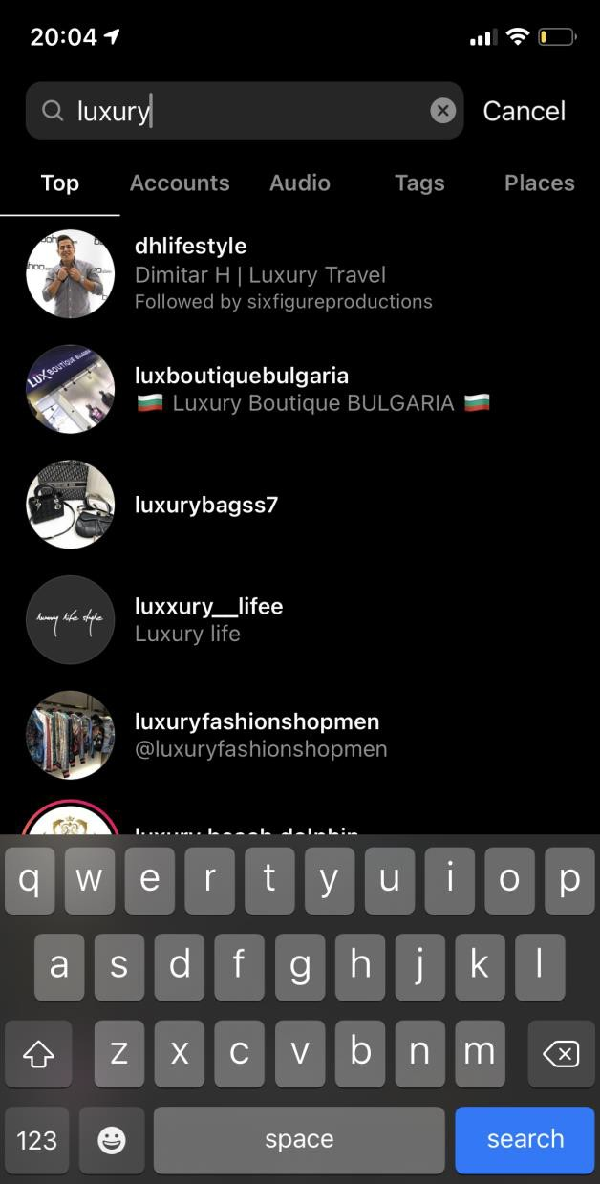
Instagram Search
How to show up on search:
  Handle and profile name
  Keywords and locations in your bio
  Keywords and hashtags in captions

Slide 21
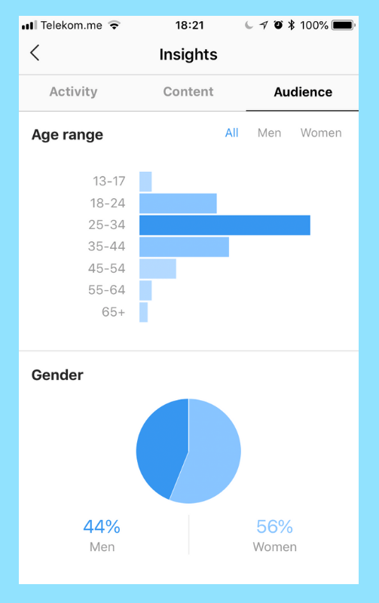
Insights
Understanding Insights to help you grow

Slide 22
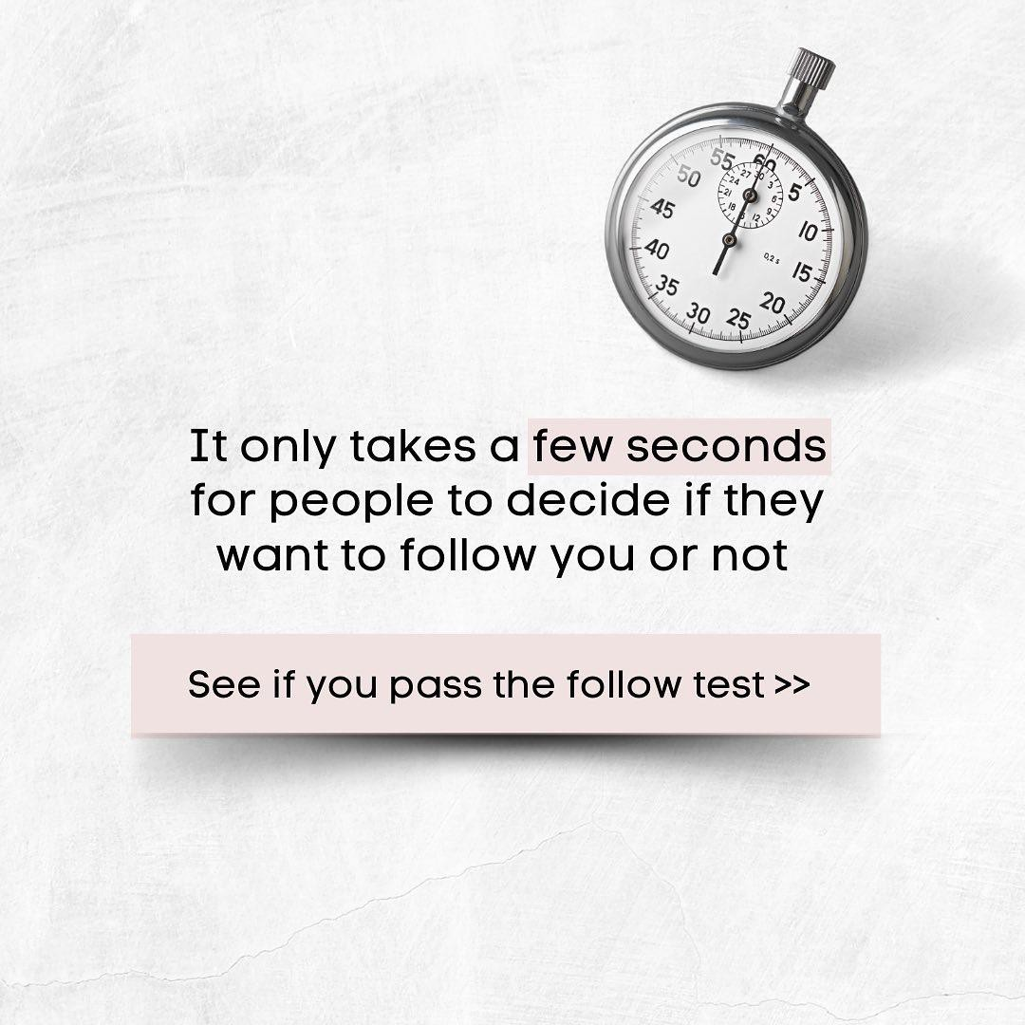
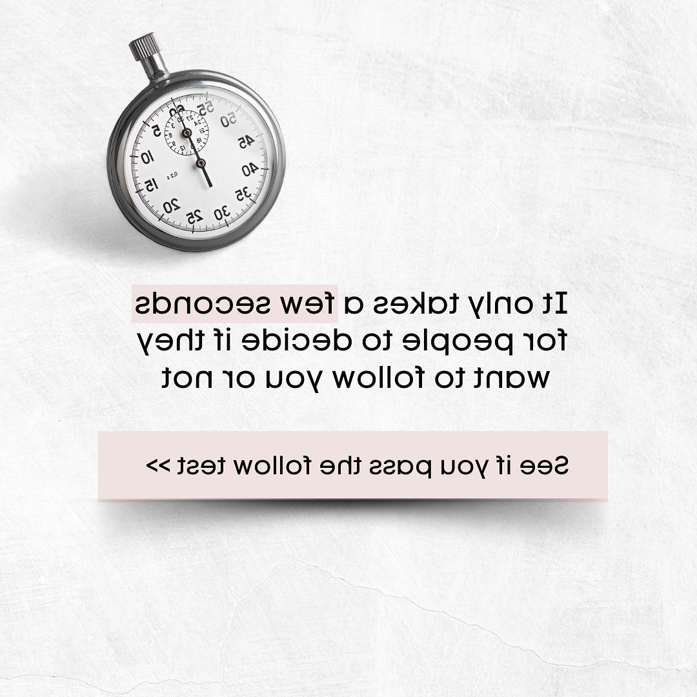
Lets Play a Game

Slide 23
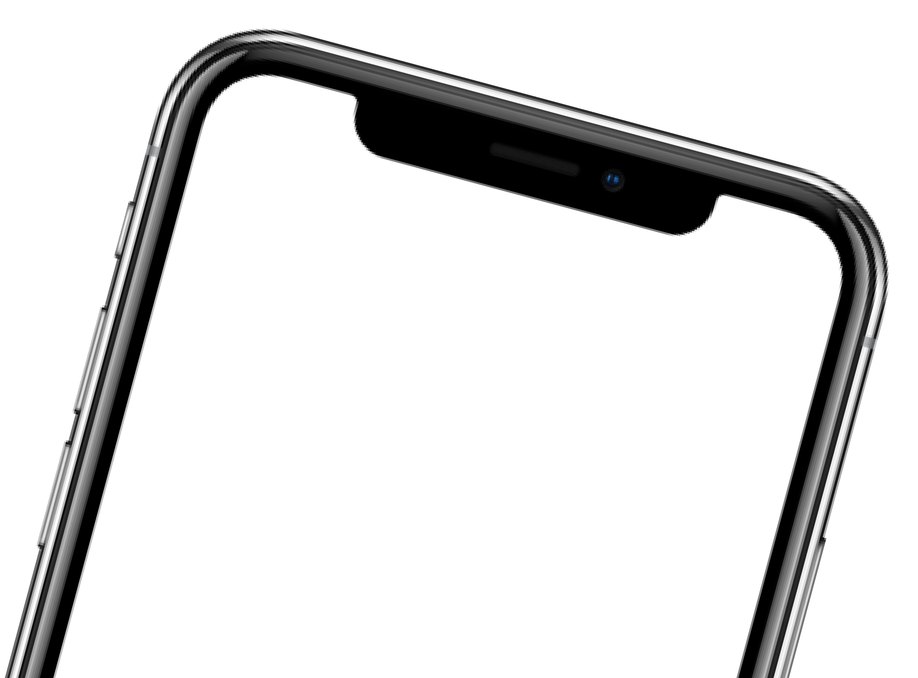
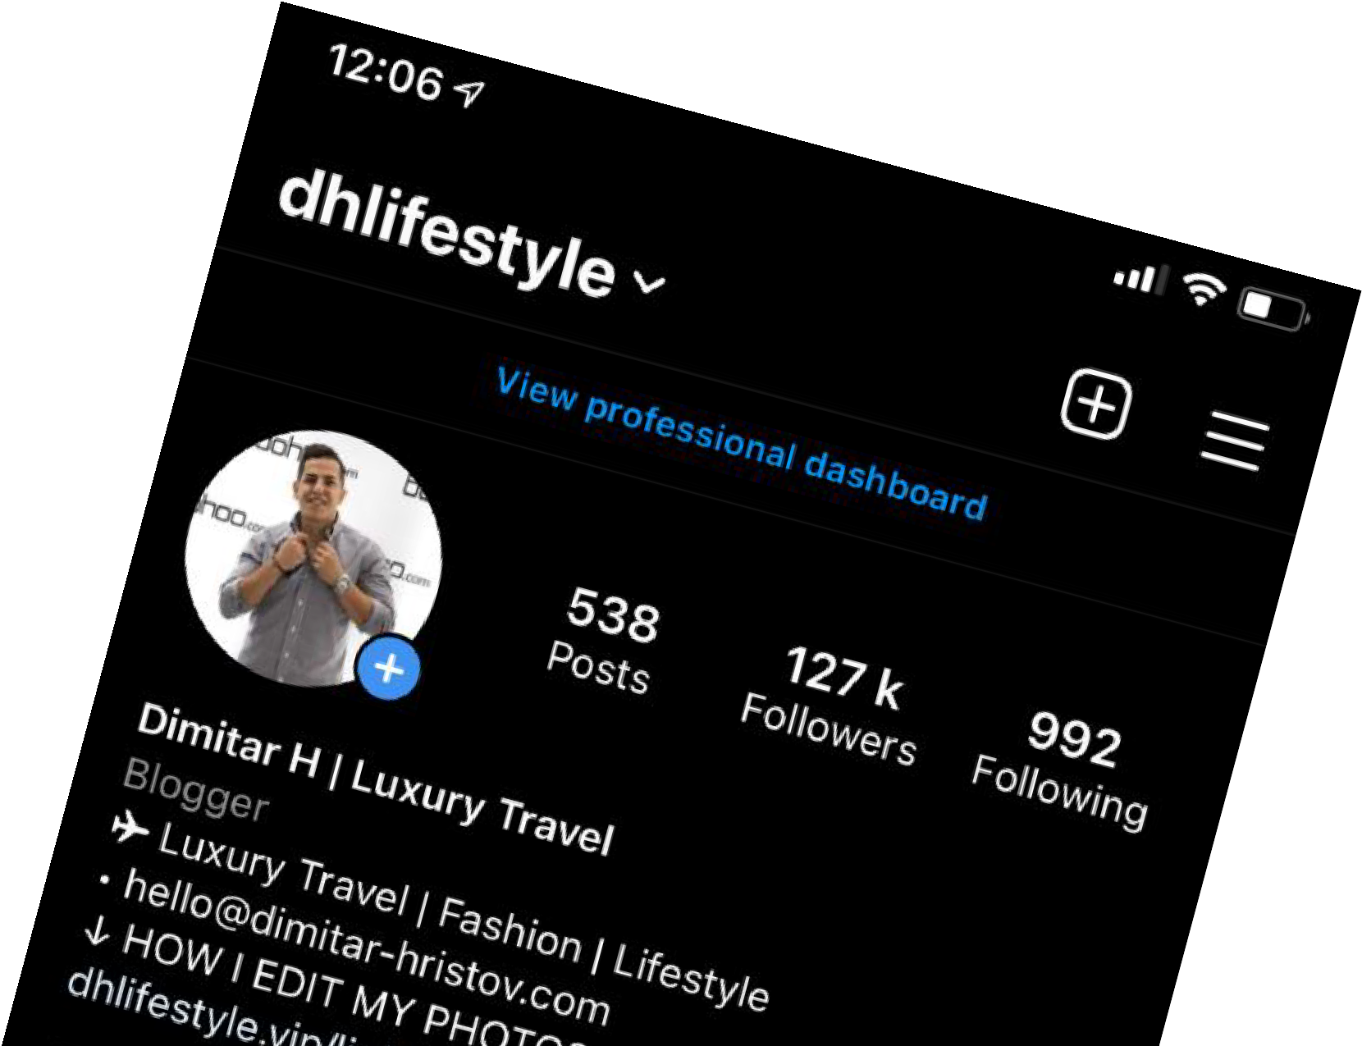
Lets Play a Game
YOUR FACE OR LOGO IN PROFILE PIC
RANDOM OBJECTS, PEOPLE, ANIMALS
5 POINTS
0 POINTS

Slide 24
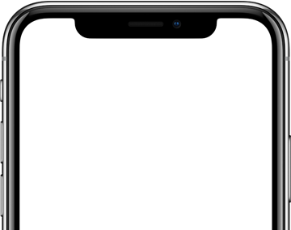
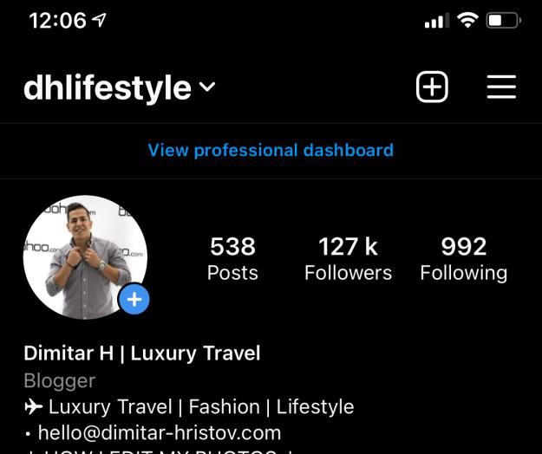
Lets Play a Game
KEYWORD IN THE NAME LINE
NO KEYWORD
5 POINTS
0 POINTS

Slide 25
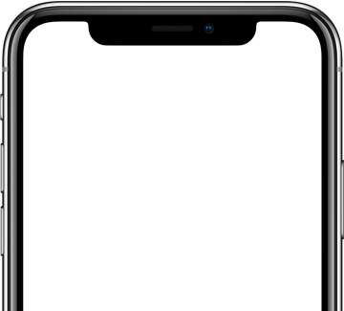
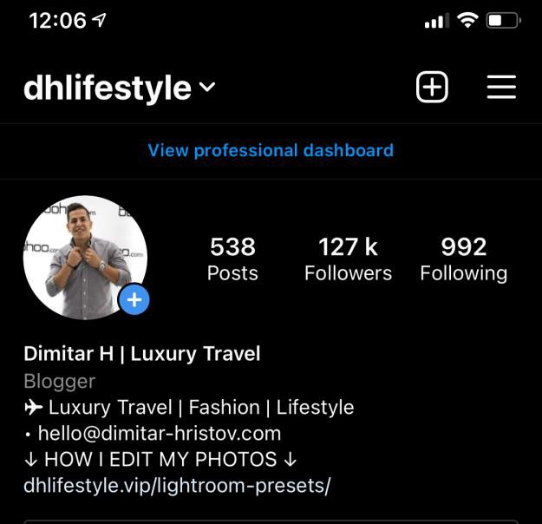
Lets Play a Game
A LINE THAT CLEARLY STATES WHAT YOU DO
UNCLEAR DESCRIPTION
5 POINTS
0 POINTS

Slide 26

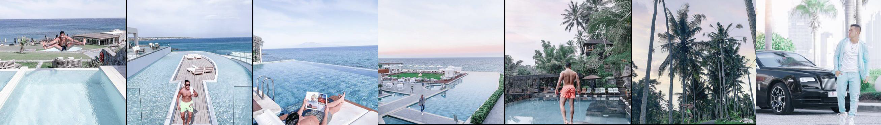
Lets Play a Game
DESCRIPTION IN BIO MATCHES
THE CONTENT ON FEED
DESCRIPTION DOESN’T MATCH
THE CONTENT ON FEED
5 POINTS
0 POINTS

Slide 27
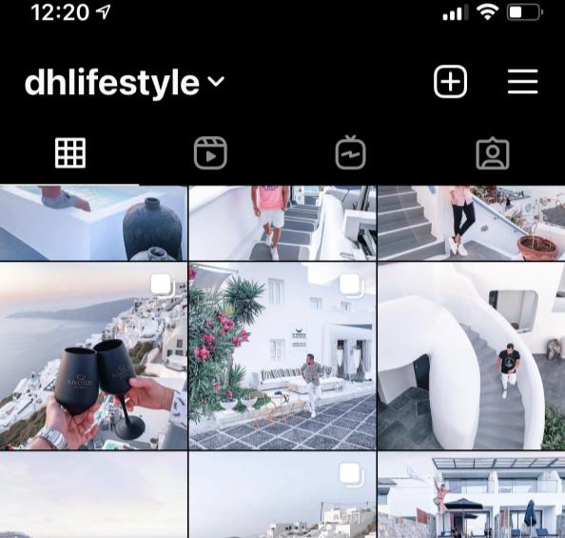
Lets Play a Game
YOU CAN TELL WHAT THE PROFILE IS ABOUT FROM THE LAST 9 POSTS
POSTING ABOUT RANDOM CATEGORIES
5 POINTS
0 POINTS

Slide 28
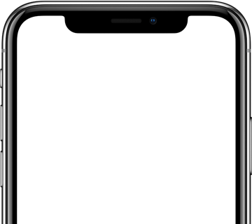
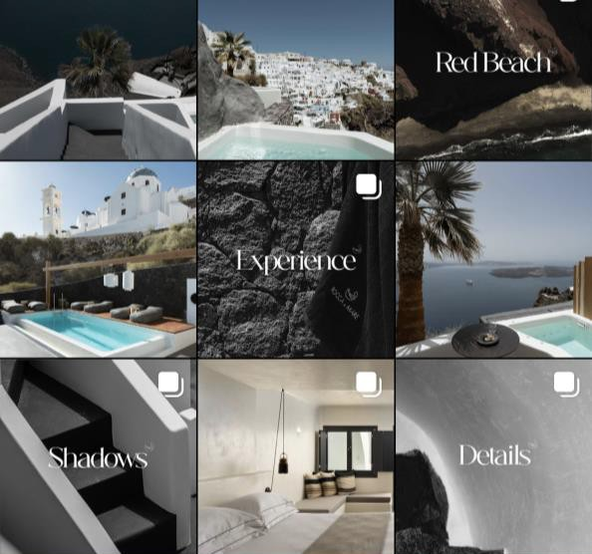
Lets Play a Game
COHESIVE FEED (SAME COLORS, FONTS, FILTERS)
RANDOM COLORS, FONTS, FILTERS
5 POINTS
0 POINTS

Slide 29
What’s Your Result?
0-10 POINTS
You have to start somewhere! Go through the slides and see what you can improve.
You are doing great!
Go through the slides and see what you can improve.
10-20 POINTS
20-30 POINTS
Congrats!
Your profile is worth a follow!

Slide 30
The Perfect Bio
1. username
2. PP
Posts
Followers
Following
+

Slide 31

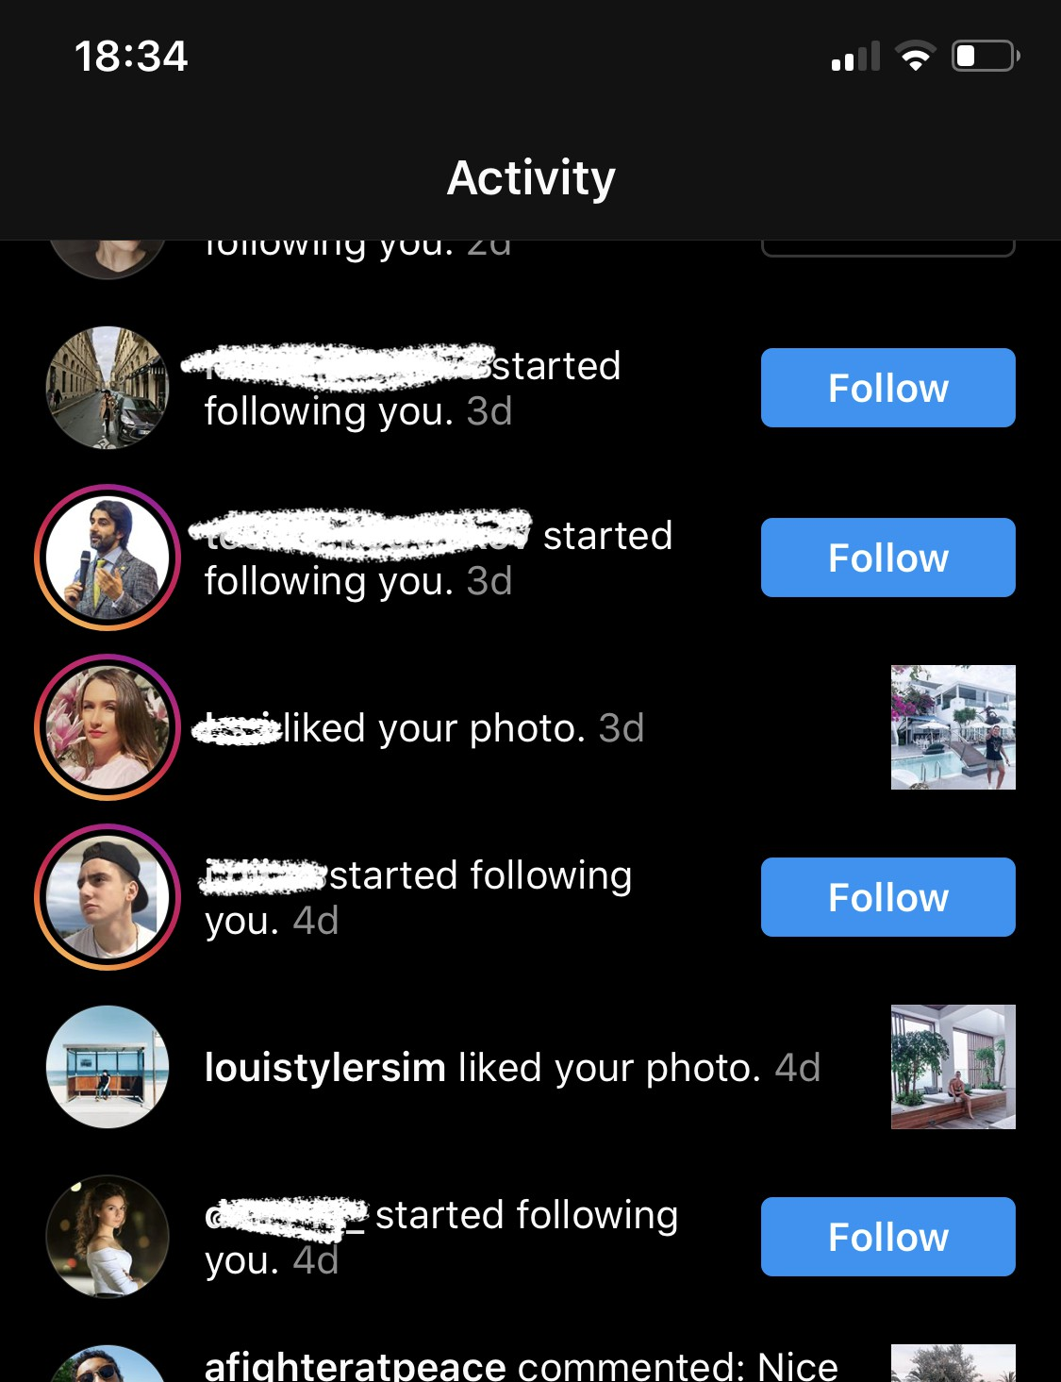
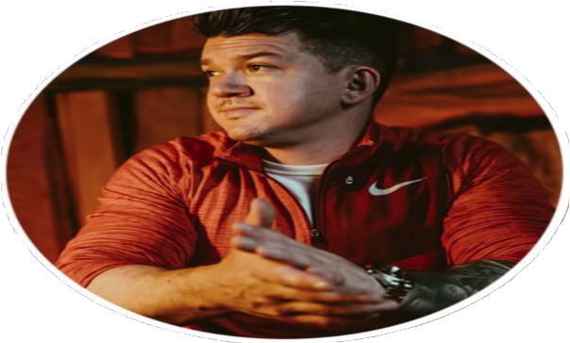
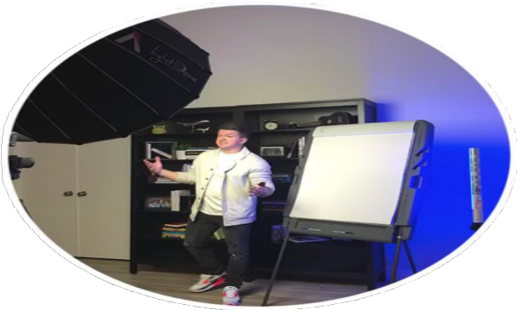


Profile Photo

Slide 32
The Perfect Bio
1. username
2. PP
3. x
Posts
Followers
Following
4. Profile Name
+

Slide 33
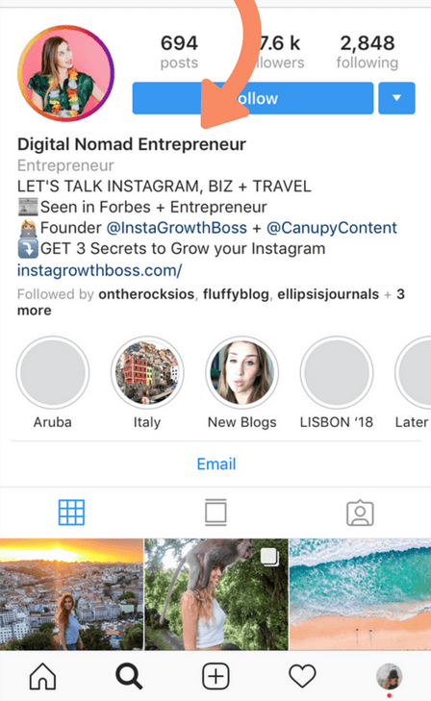
The Perfect Bio
Profile Name
Keep your handle name as your
name itself
Write down your full name
Mix your name + your profession
30 characters - Dimitar H | Travel

Slide 34
The Perfect Bio
1. username
PP
x
Posts Followers Following
Profile Name
1. HOW CAN YOU HELP THEM? OR WHAT DO YOU DO?
Consider this as a solution statement, in which you provide a solution to a common problem on the Instagram hemisphere. If you are not an educational brand, then it can be something very direct, in which you tell them what you do.
For instance, I teach and help people about Design
+

Slide 35
The Perfect Bio
1. username
PP
x
Posts Followers
Following
Profile Name
2. HOW DOES YOUR PROFILE HELP THEM?
We all want to take inspiration from other profiles and act on it. Your 2nd line, should define as to why your content will benefit them.
For instance: Sharing Tip/Tricks daily on content creation
+

Slide 36
The Perfect Bio
1. username
PP
x
Posts Followers
Following
Profile Name
3. HOW CAN THEY LEARN FROM YOU?
Now that they have understood what you provide, if they want to reach out to you personally,
then how can they do it. You can either redirect them to an e-mail or ask them to DM you.
For instance: DM for Help/ Consultation/ Content/ Branding
+

Slide 37
The Perfect Bio
1. username
PP
x
Posts Followers
Following
Profile Name
4. OTHER INFORMATION OR A CREDIBLE ACCOLADE
Now, that they know how to reach you, the last line is more like an accessory line, which can keep changing as per time. In which you can mention your achievements or encourage them to click on the link below to re-direct them to something important that adds value to them.
+

Slide 38
The Perfect Bio
1. username
PP
x
Posts Followers
Following
Profile Name
5. WEBSITE LINK
where do you want to re-direct people?
+

Slide 39
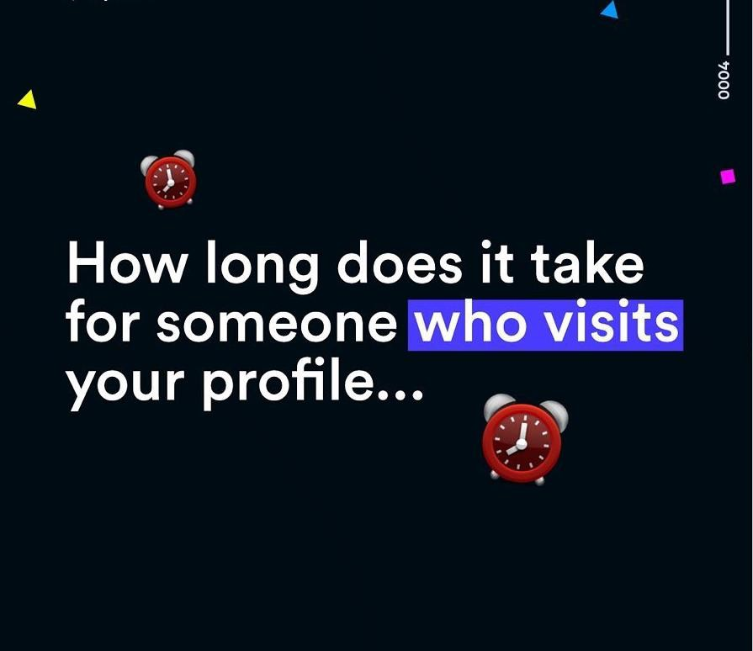
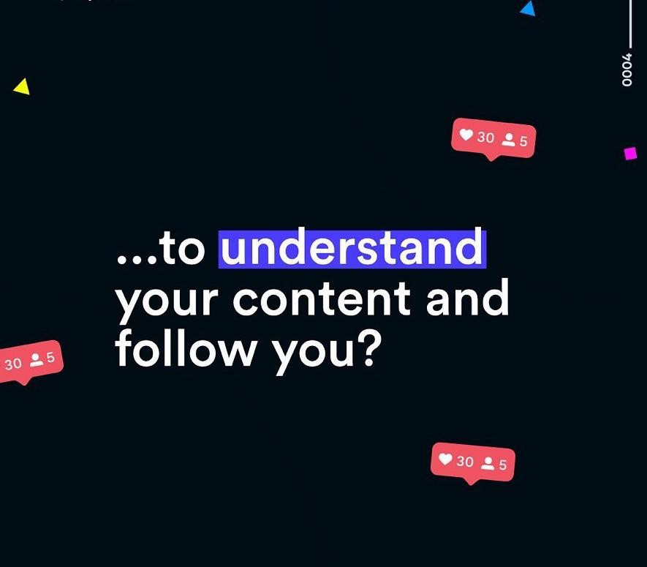
Why Highlights Are Huge

Slide 40
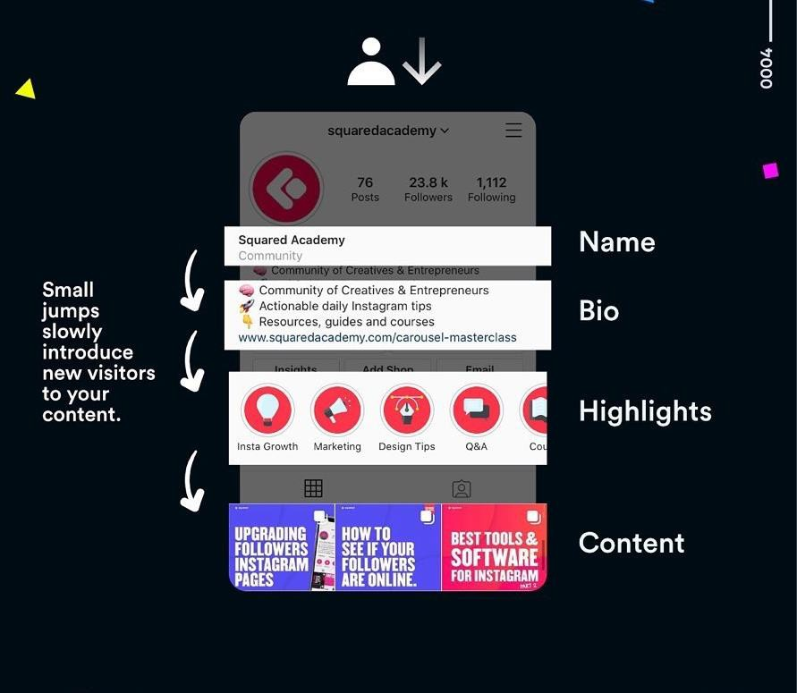
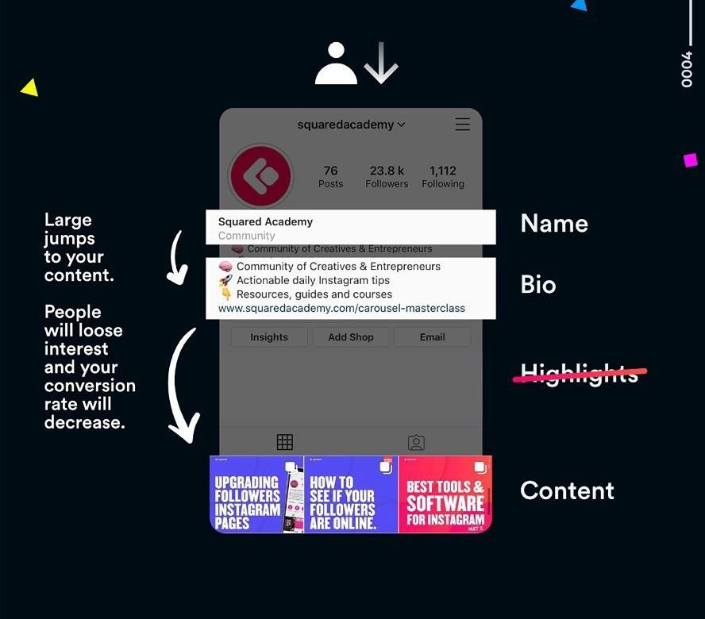
Why Highlights Are Huge
Dimitar Hristov
Dimitar Hristov
yourlink.com
yourlink.com

Slide 41
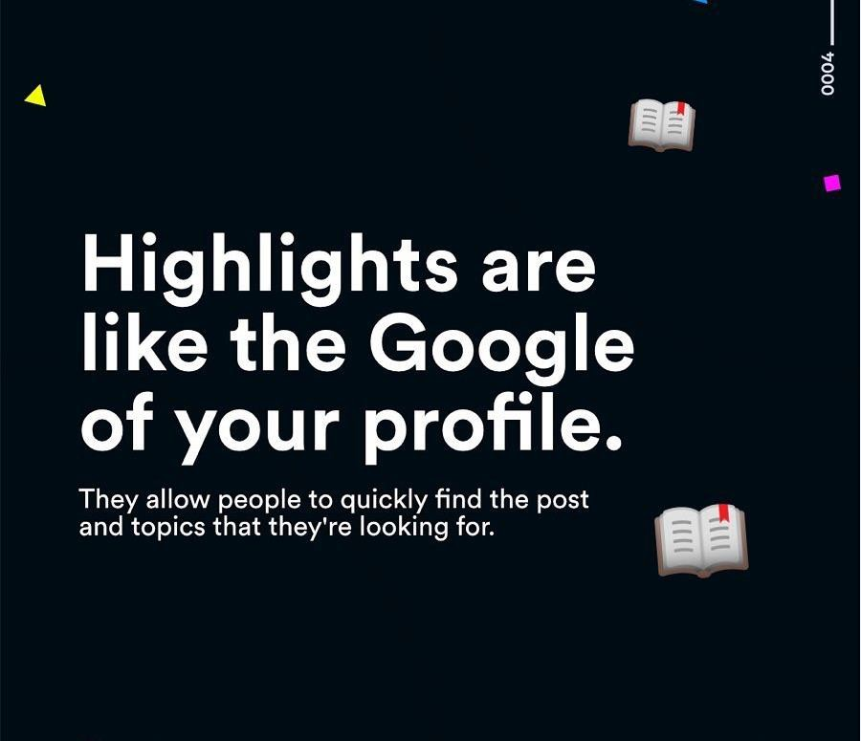
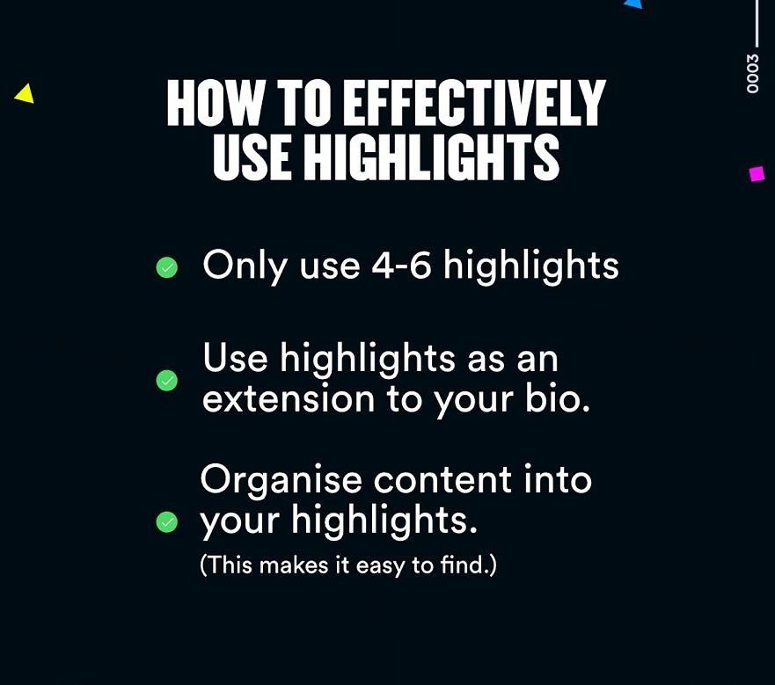
Why Highlights Are Huge

Slide 42
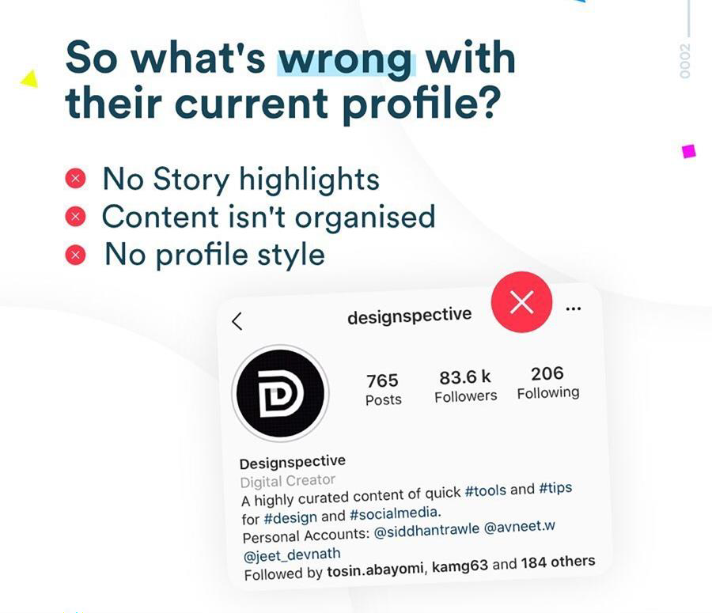
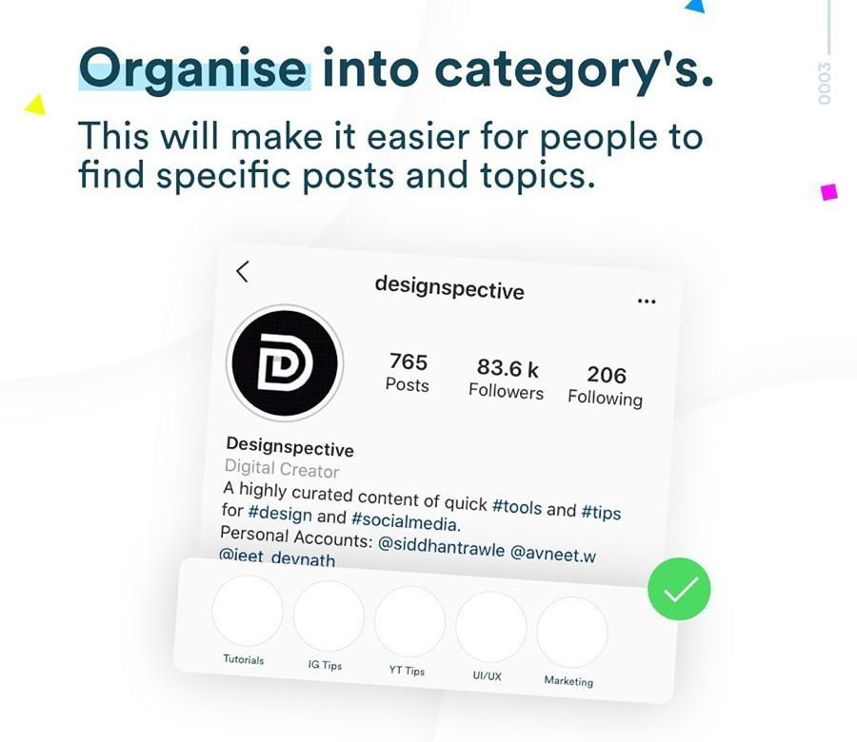
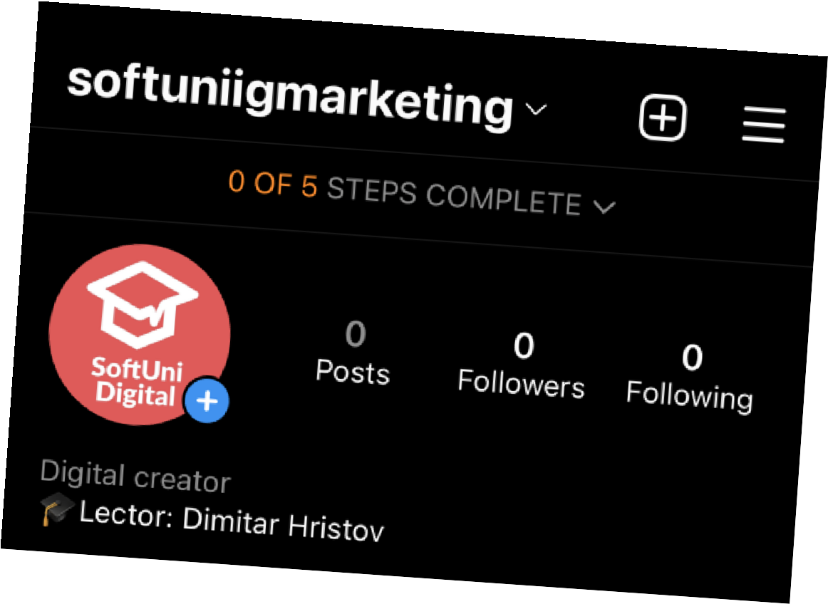

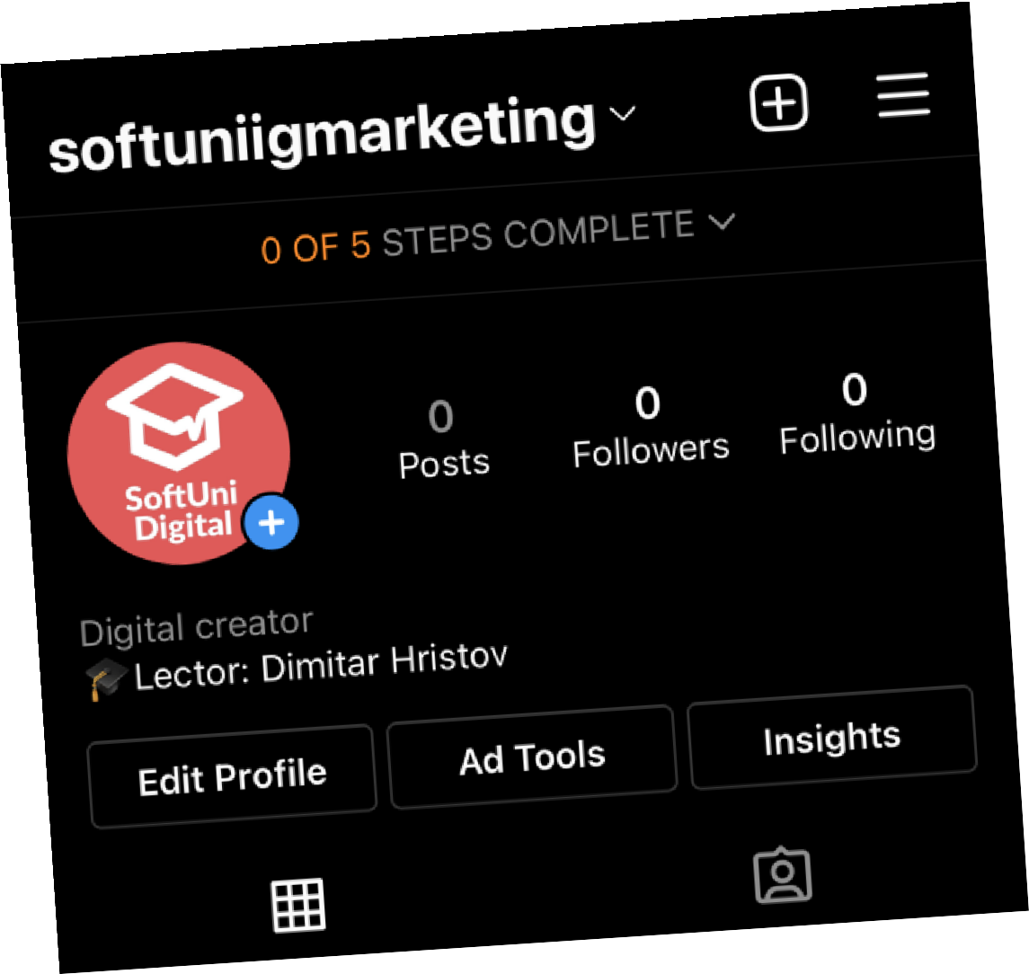

How to Use Highlights

Slide 43



How to Use Highlights

Slide 44


The Perfect Bio
Putting it all together
Choose a creative username
Mix your name + your profession
Use keywords 1-2 hashtags (opt)
Play with emojis
Clear call to action
Website link - https://biolinky.co/

Slide 45
Homework
Think about how you can implement all the tips for you or your brand based on today’s discussion
Optimize your entire profile with a thoughtful bio and a new profile picture.
Create highlights with covers.
Make a screenshot of your profile before and after you make the changes.
***Use the profile of “youth.priorities”

Slide 46


How to Build Trust
1
Showing your face / your team
in stories and feed posts

Slide 47

How to Build Trust
2
Authority statement
in your bio

Slide 48

How to Build Trust
3
Client testimonials in your
highlights, feed & stories

Slide 49


How to Build Trust
4
Media mentions in your
bio, feed and stories

Slide 50

Things that decrease trust
Very high number of people you are following It indicates follow/unfollow action
Strange ratios between followers/likes/comments This indicates that you bought fake followers
Hashtags like #follow4follow, #like4like
This indicates that you are trying to trick Instagram

Slide 51


Lead Generation
Lead Generation
16
Why do you need a landing page?
You have control over everything
You can sell your own product
You can create meaningful offers
You can create a newsletter

Slide 52
Why You Need a Landing Page
Instagram could delete your account tomorrow for no reason.
You don’t own your followers but you own your e-mail list.
You need to incentivize people to sign-up for your list. Simply having newsletter doesn’t cut it anymore. Give them something free for an e-mail address in return.
Sales process (funnel)
For low-price products it can be simply: content -> link in bio -> checkout

Slide 53










Affiliate Marketing
18
Affiliate marketing is a marketing model in which third-party publishers promote a merchant's goods or services and receive a percentage of the sales or web traffic generated as a result. It is typically considered a key part of modern digital marketing.
Sign up as an affiliate.
Use the provided unique URL link or code in your post(s).
You receive a percentage of every purchase made.

Slide 54

How to give value
6
Identify what’s valuable

Slide 55

How to give value
7
Identify what’s valuable

Slide 56

How to give value
8

Slide 57

How to give value
9
Share that content

Slide 58

Creating vs Curating Content
10
Creating
Making something from scratch
Takes more time and effort
You have full control of everything (e.g. branding)
Requires tools
Opportunity to be creative
You need to figure out what works
Novelty. You are the 1st
Adds value if done well
Curating
Sharing something created by someone else
Efficient way to make content
Limited control with a need to credit the source
Can be done with a phone or computer
Doesn’t sharpen your creativity
Using content that’s already working
You can only be the 2nd. Like a remix.
Adds value if done well

Slide 59


How brands use carousel
12

Slide 60


How brands use carousel
13

Slide 61


More Carousel Ideas
15

Slide 62


More Carousel Ideas
16

Slide 63


How to create content easily

Slide 64


How to find topics for content

Slide 65



How to find topics for content
26

Slide 66

How to find topics for content
27

Slide 67





How to write a copy
29
vs

Slide 68
Measuring Success
8
In order to access this you need to:
Switch to Business Profile.
On the Connect Your Facebook Page screen, you’ll
see all of the Facebook Pages you’re currently an admin on. Select the Page you’d like to associate with your Business Profile on Instagram.
On the Set Up Your Business Profile page, review your business’s contact information, make any changes, and tap Done.

Slide 69
Measuring Success
9
Instagram overall – Profile analytics
Follower count: The number of people following your Instagram account Impressions: The total number of times all of your posts have been seen Reach: The number of unique accounts that saw any of your posts Profile views: The number of times your profile was viewed
Website clicks: The number of taps on the website link in your profile bio Call clicks / Email clicks: The number of taps to call or email your business Posts: The number of Instagram posts you have published
Mentions: The number of Instagram posts mentioning your Instagram handle
Branded hashtags: The number of Instagram posts with your branded hashtags

Slide 70

Measuring Success
10
How to find your engagement rate?
Engagement rate is the percentage of followers or viewers that engage with your posts. Generally, if you want to calculate your average engagement rate for Instagram, you would divide the number of likes and comments by your follower count, which will give you a percentage.

Slide 71
Analyzing other pages
12
Public vs Private
If two accounts are the same size, but one is on Public and the other on Private, and they have the same amount of engagement per post, the page on Private will likely be the more active page.
This is because all of the engagement is coming from its own audience.
Anyone who is not following the page can’t like or comment or even seen the posts, nor
can that account hit the Explore Page. Public pages, on the other hand, especially those that hit the Explore Page regularly, will show extremely high engagement, but this can be deceitful because it is not a true representation of the accounts organic views and engagement.

Slide 72

Instagram Advertising
11
73% of young adults in the U.S. say Instagram is the best way to reach them about new products or promotions
1 Billion + Monthly Active Users
500 + Million daily Instagram Story Users
849.3+ Million advertising reach potential

Slide 73


Instagram Promote vs FB Ads
12
Ads manager allows you to select
different ad formats
Your ad placements go beyond the newsfeed
Use different objectives
You can use your Pixel
Lookalike audiences
In-depth reporting

Slide 74

Types of Instagram Ads
13
1. FEED

Slide 75

Types of Instagram Ads
14
2. STORY

Slide 76

Types of Instagram Ads
15
3. SHOP

Slide 77



Live Training
16
Live Training
Creating an ad together using the Promote feature
Analyzing insights

Slide 78

Задача
1
Създайте поне 6 поста с някой от посочените в презентацията layouts (checkboard, horizontal line, vertical line, brand colors или друг) и използвайте запомнящо се име на профила, био/описание, CTA и дизайн на highlights.
  Създайте “About me” или “About us” (за бизнеси) highlight, в който да обясните с 1-2 видеа или снимки повече за вас или за вашият бранд и защо си заслужава да ви следят.
  Създайте видео за IG.
  Предложение за колаборация – селектирайте подходящи профили и опишете по какъв начин ще подходите.

