Slide 1
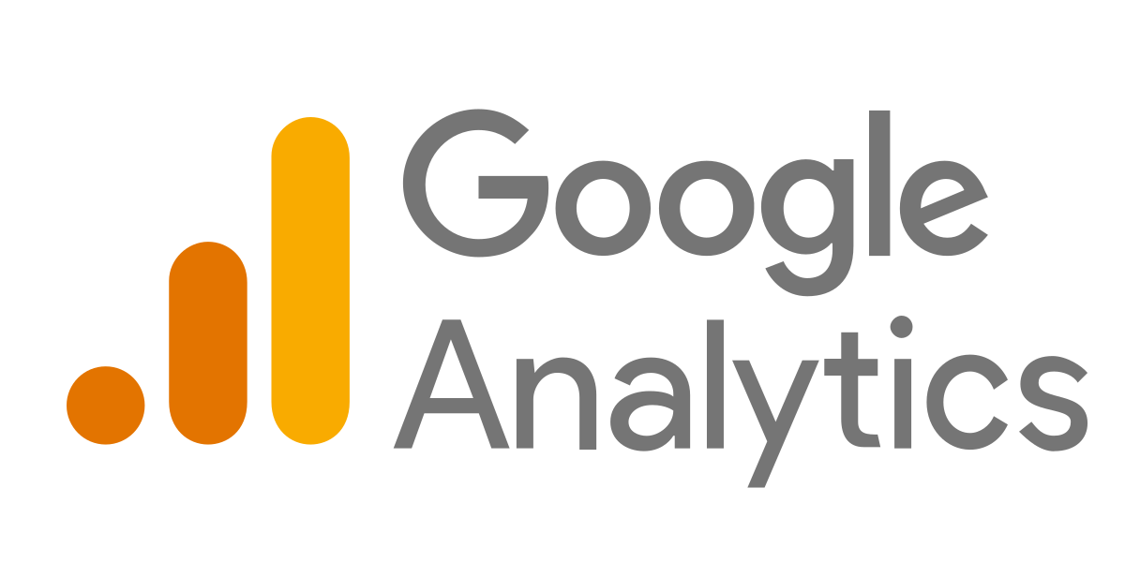

Slide 2
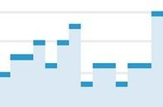
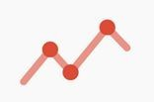



Google Analytics: the world leader in web analytics
More than 10M websites now use Google Analytics. In fact, more than
82% of web trafﬁc is measured by Google Analytics!*
Dashboards
Real-time
Data
Custom Reports
Advanced Segmentation
Path Analysis
*http://w3techs.com/technologies/overview/traﬃc_analysis/all

Slide 3
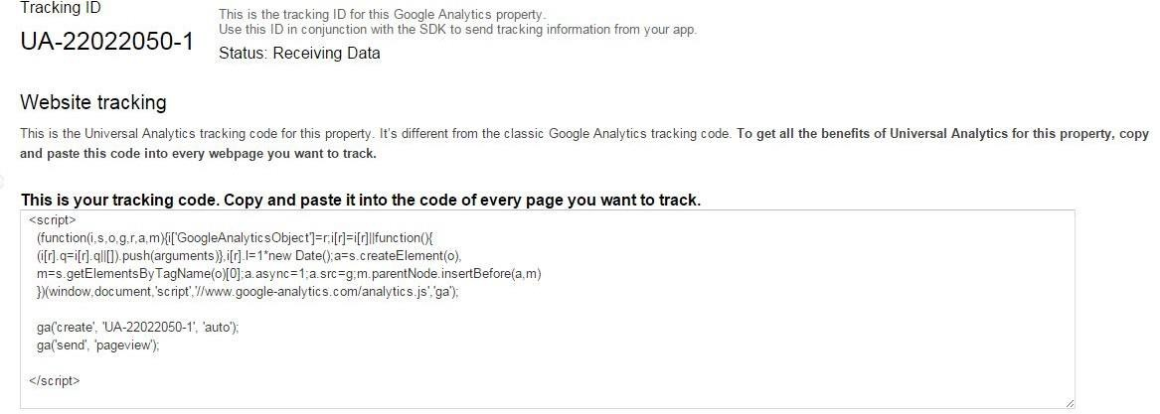
Implementation and customization

Slide 4
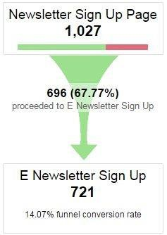
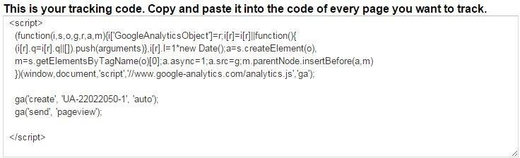
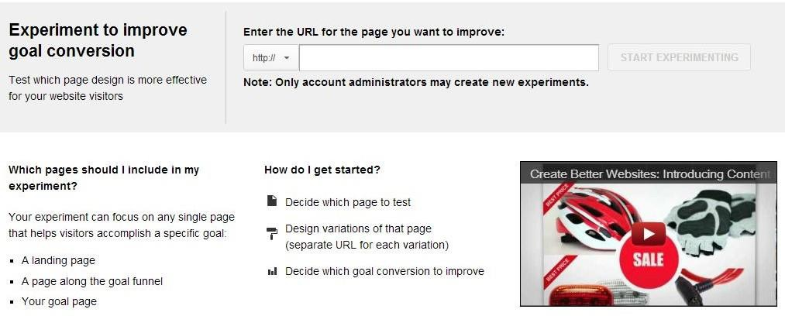
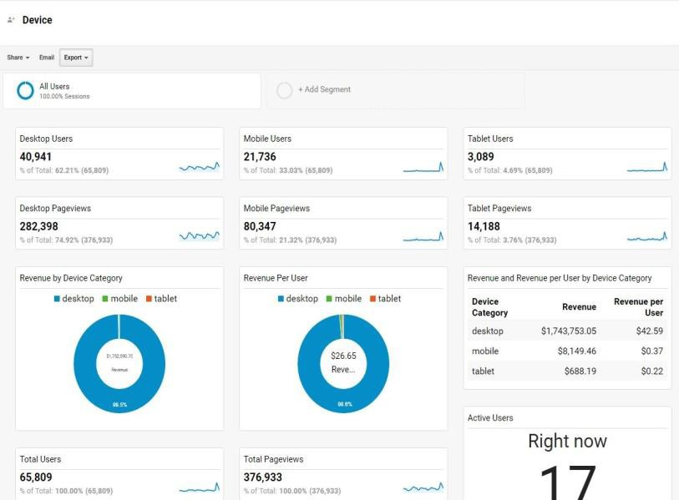

Implementation and customization

Slide 5
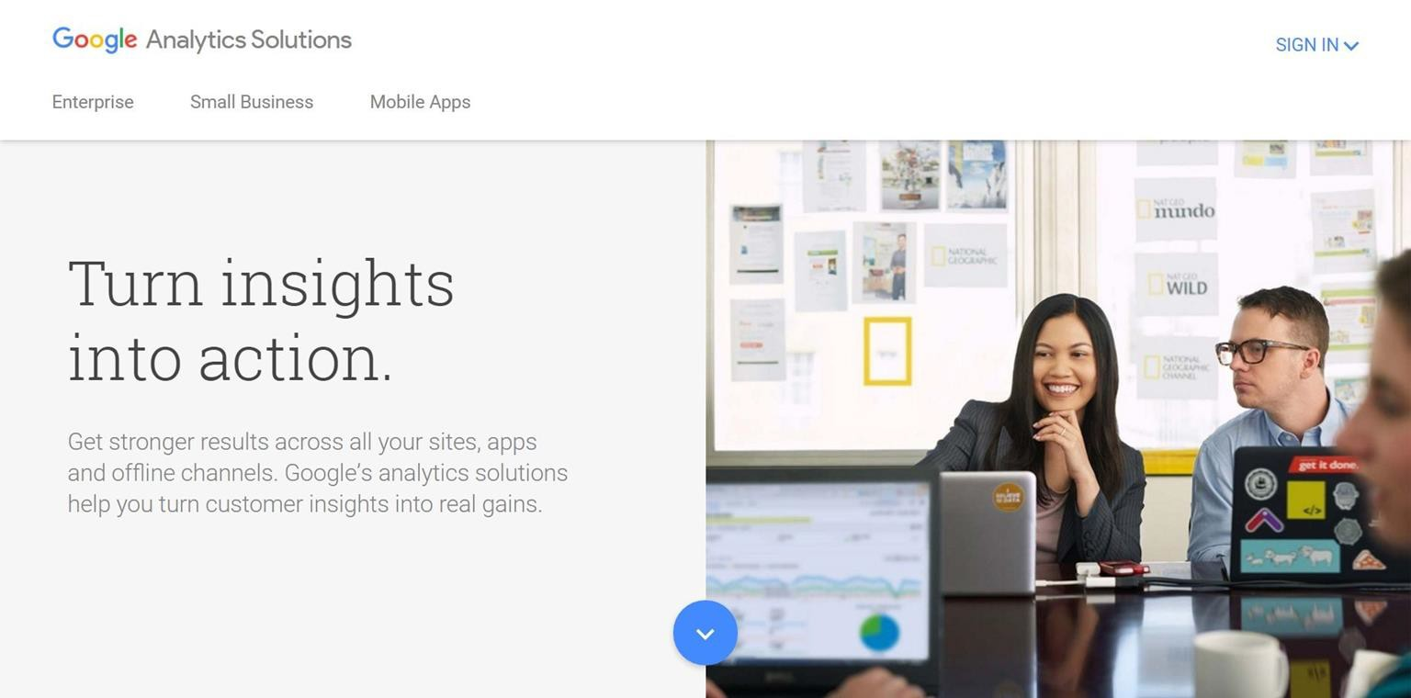
How can I sign up?

Slide 6
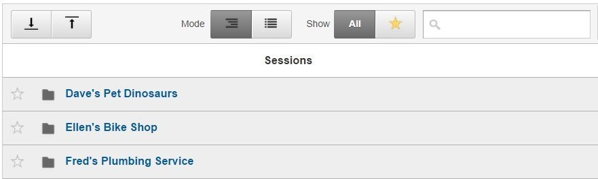
Google Analytics uses an account structure to organize the data from multiple websites and clients.
Account
Property
View

Slide 7
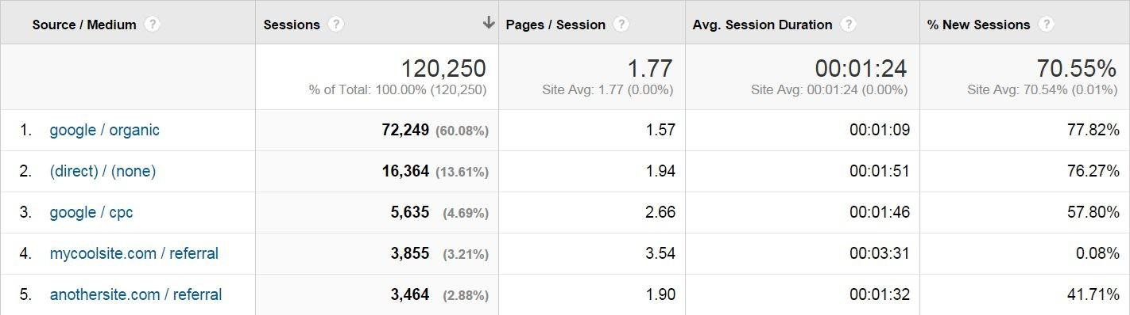
Google Analytics collects and calculates metrics along a wide variety of different dimensions
Dimensions Metrics
Browser Country Keyword City Campaign Landing Page
Source Medium OS
Device Type
Age/Gender Session Date
Product Revenue Session
Time on Site
Goal Conversion Rate Conversions
Time on Page
Clicks Impressions
Per Session Value
% New Sessions Bounce Rate Unique Pageviews
Digital analytics & Google Analytics UI tour

Slide 8




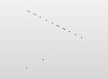
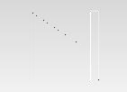
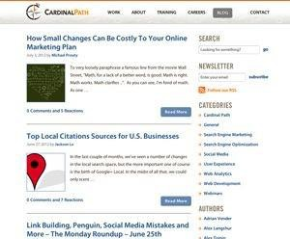
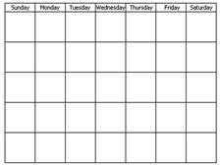



Google Analytics collects data using this hierarchy
Interactions
User
Event
Session
Pageview
Digital analytics & Google Analytics UI tour
Learn More: goo.gl/jyCEG

Slide 9
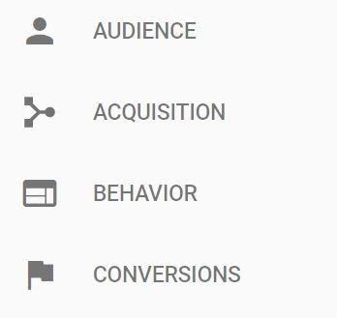
GA reports are grouped together into 4 main sections
Who are they?
How did they ﬁnd me?
What are they doing?
What are they worth to me?

Slide 10

Google Analytics Demo account
Google merchandise store
https:/ support.google.com/analytics/answer/6367342?hl=bg

Slide 11
Deﬁnitions
Google Analytics Cheat Sheet

Slide 12
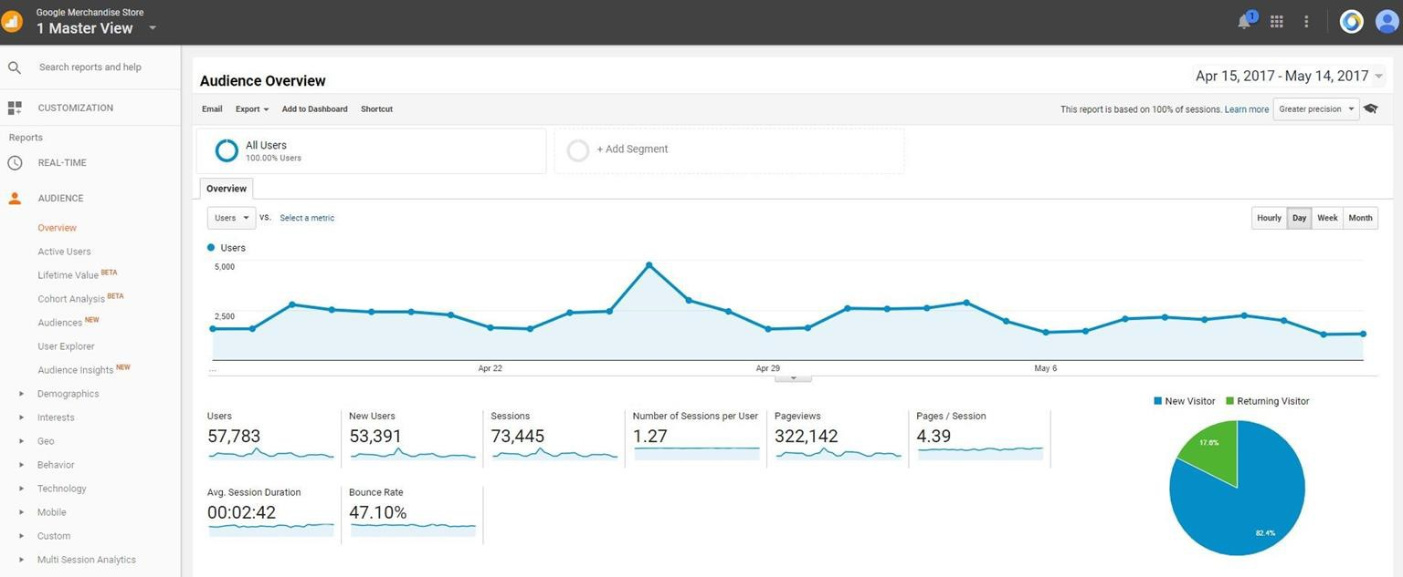
Let’s start with how Google Analytics is organized

Slide 13
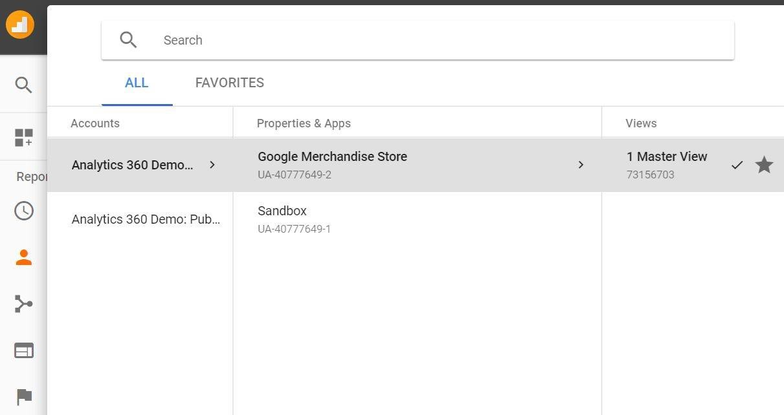
You can switch between accounts at any time

Slide 14
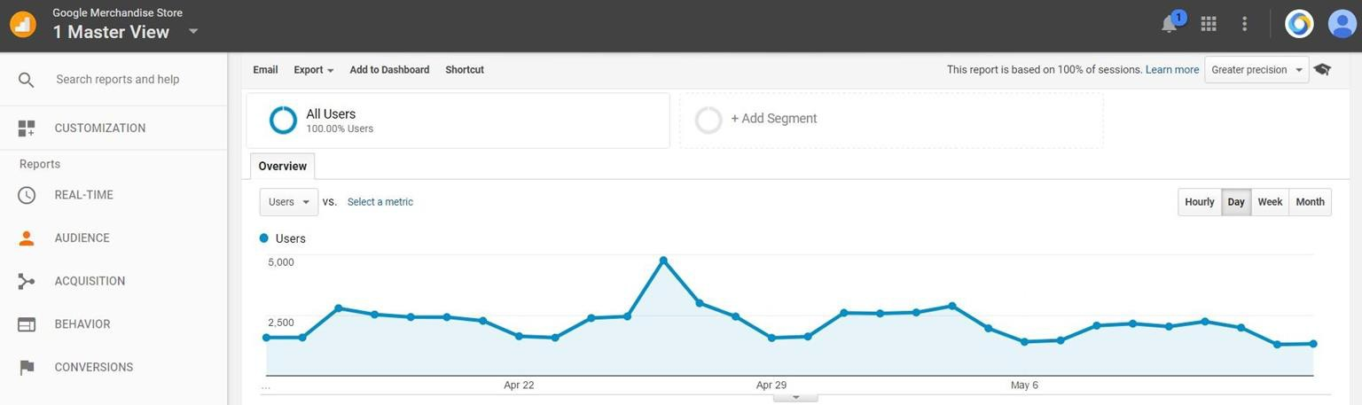
Audiences

Slide 15
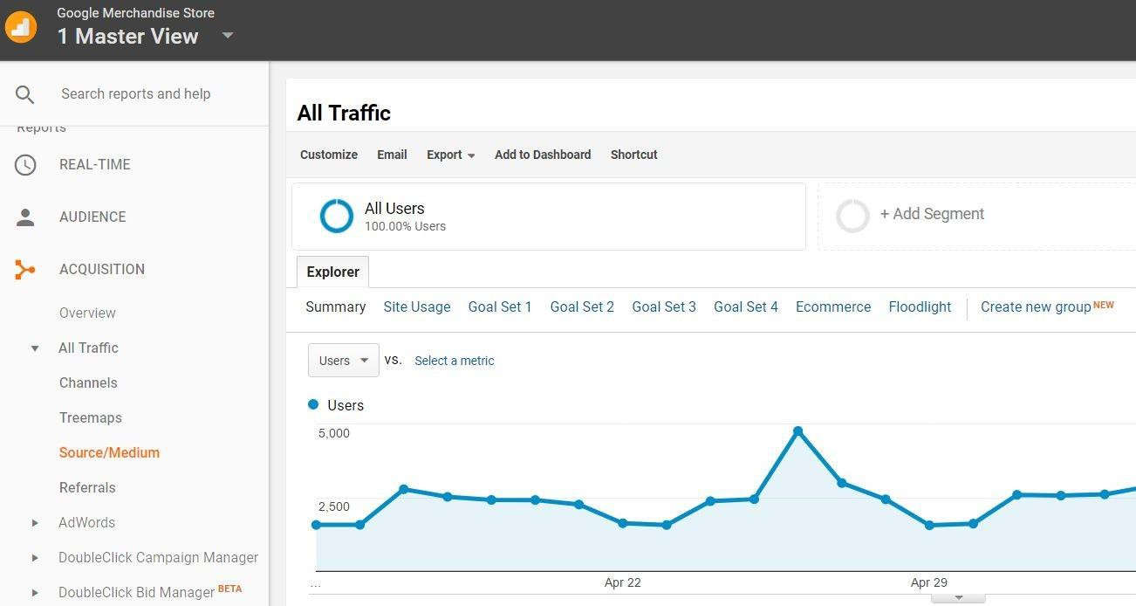
Acquisition

Slide 16
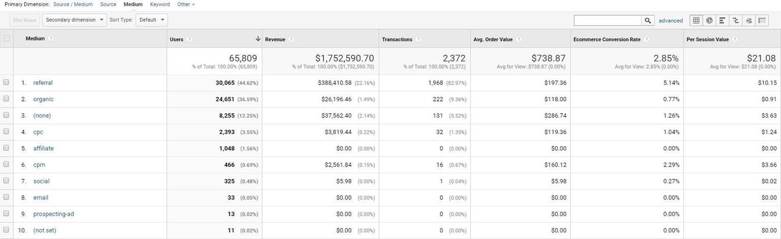

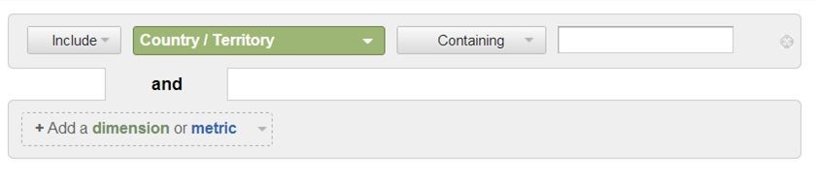
Filters

Slide 17

Filters

Slide 18
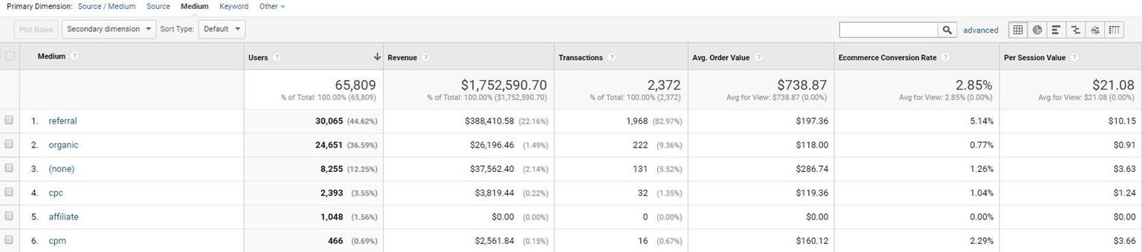

Filters
View types in Google Analytics:
Table view (default in most reports)
Pie chart
Bar graph / Comparison view
Pivot table
Word cloud
Digital analytics & Google Analytics UI tour

Slide 19
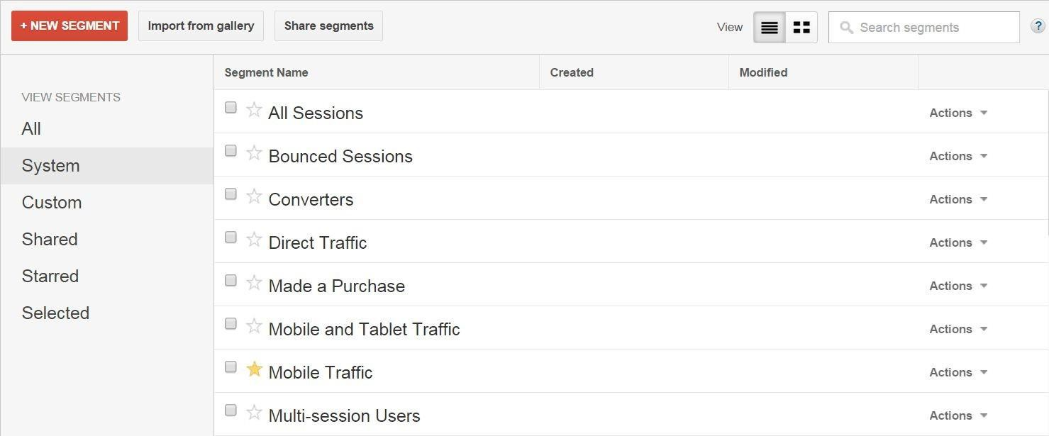
Built in segments vs. custom segments

Slide 20
Built in segments vs. custom segments
Built In

Slide 21
Built in segments vs. custom segments
Custom

Slide 22
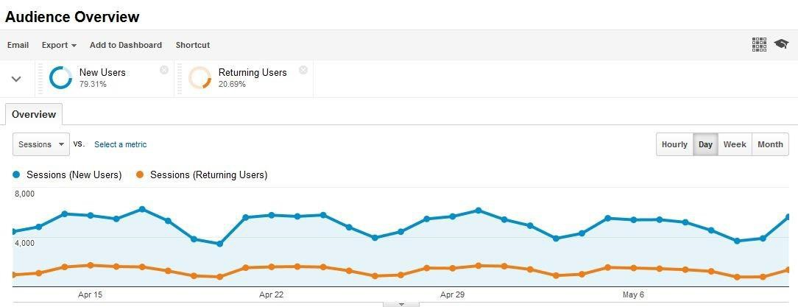

New vs. returning users

Slide 23
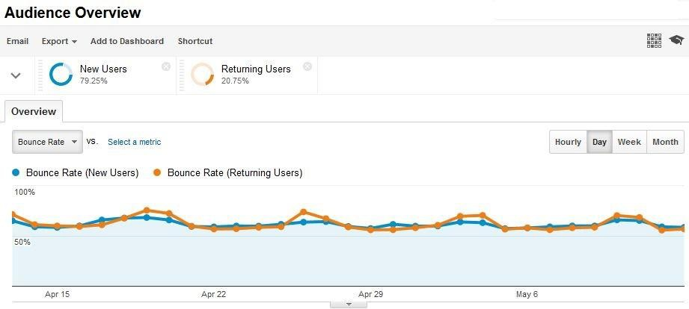
New vs. returning users

Slide 24

Built in segments are great. Custom segments are better!

Slide 25
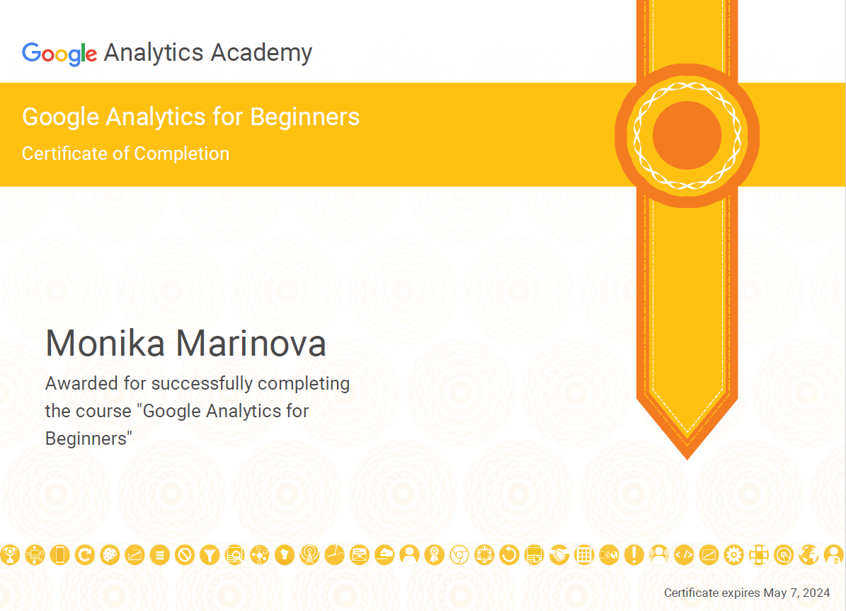
Google Analytics course for beginners
https://skillshop.docebosaas.com/learn/courses/8108/get-started-using-google-analytics

Slide 26
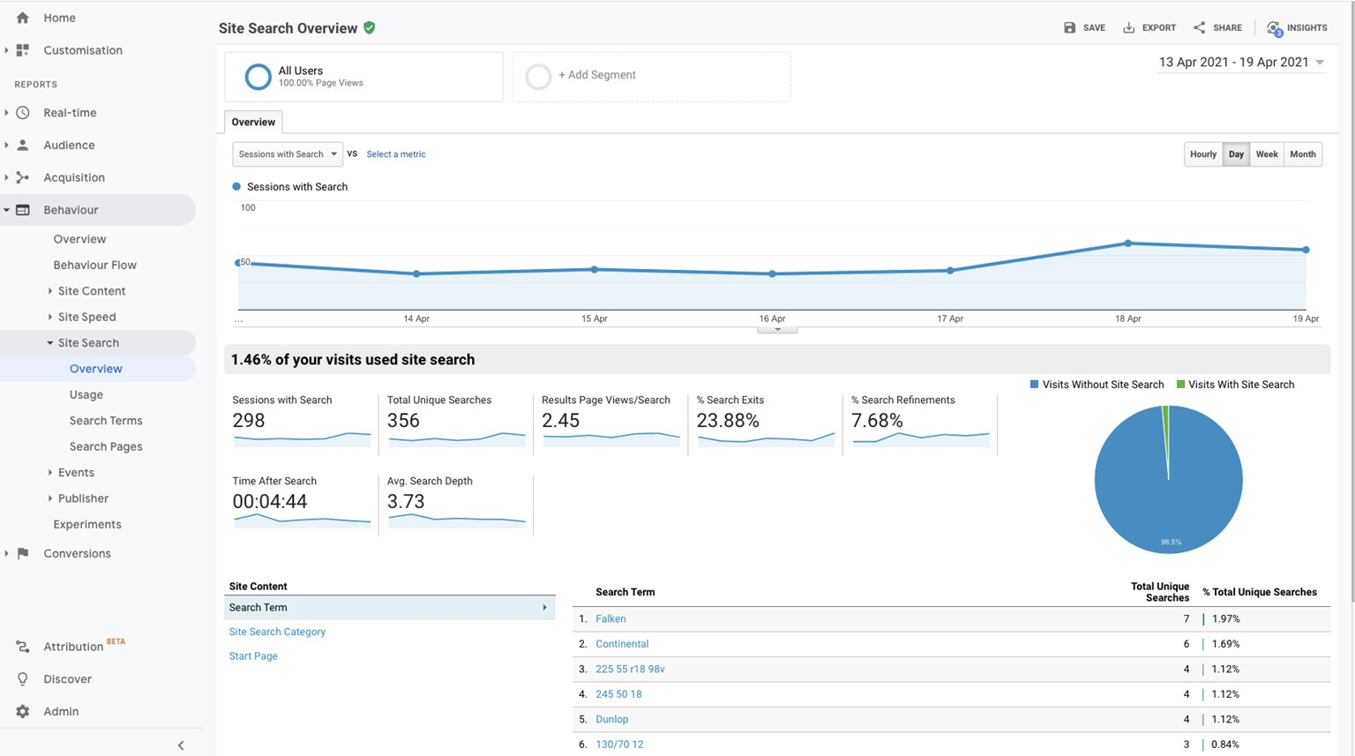
Site search report

Slide 27
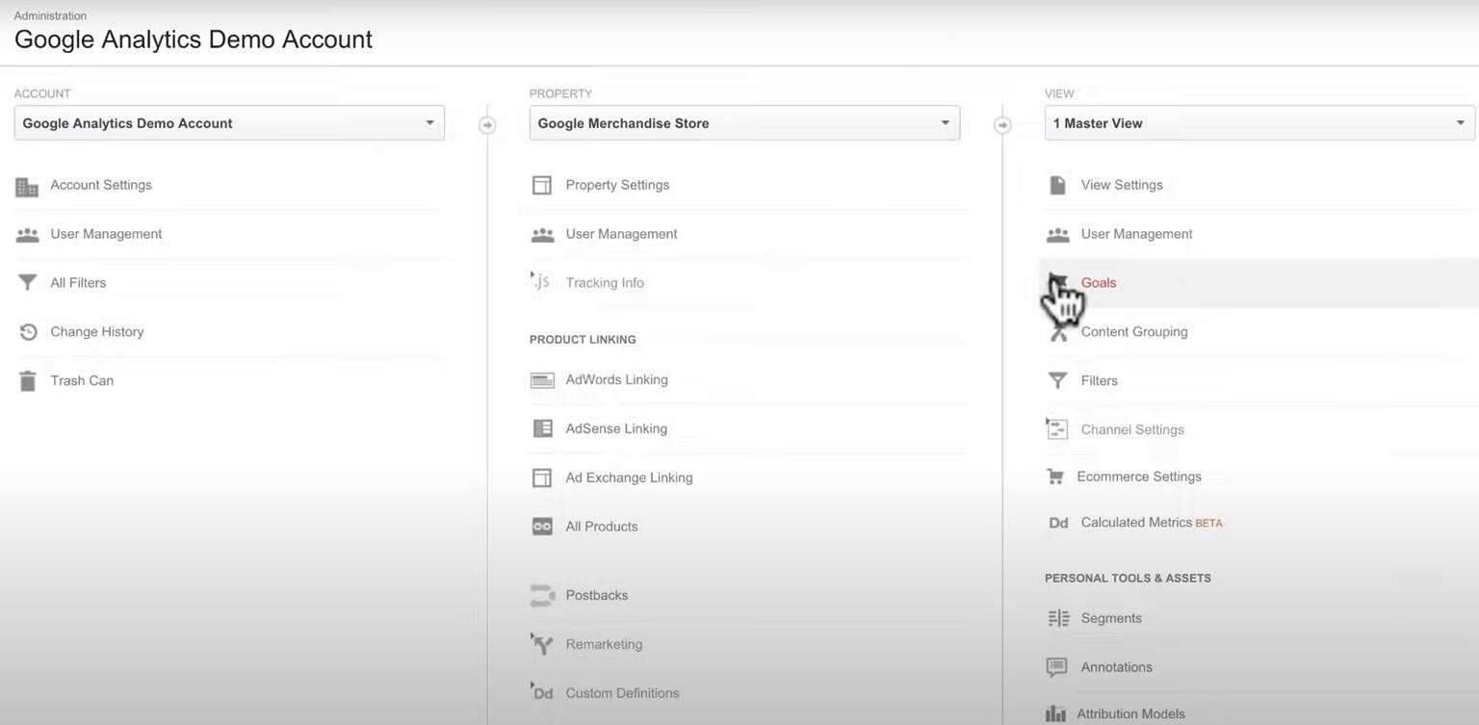
Goal setup

Slide 28
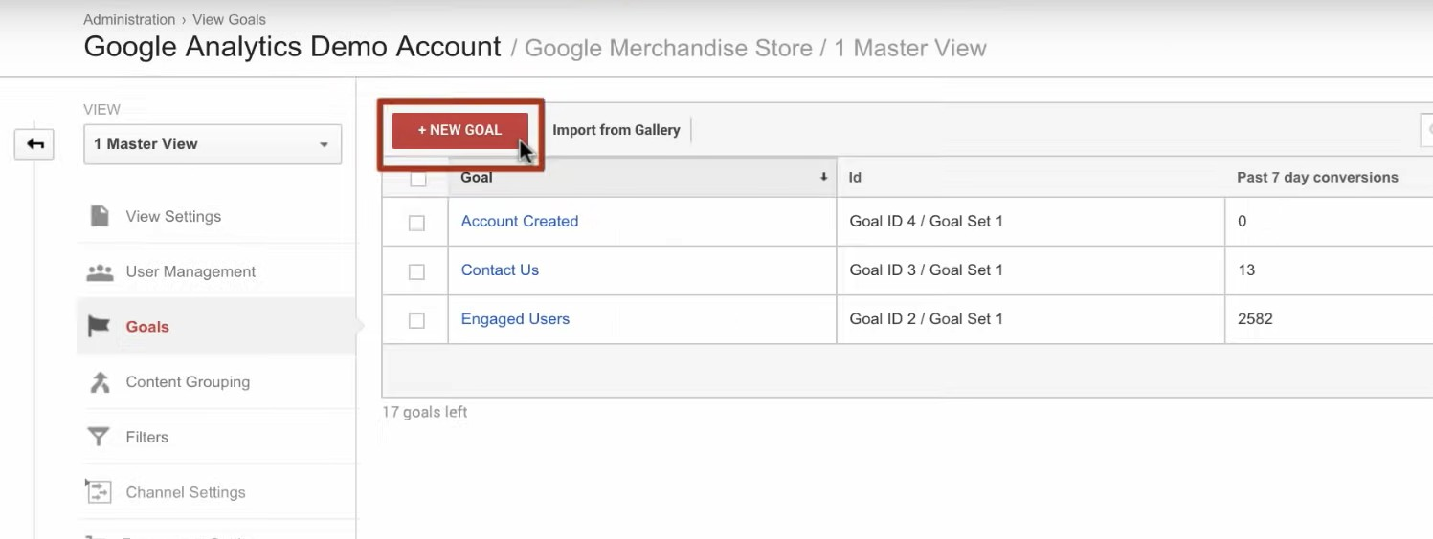
Goal setup

Slide 29
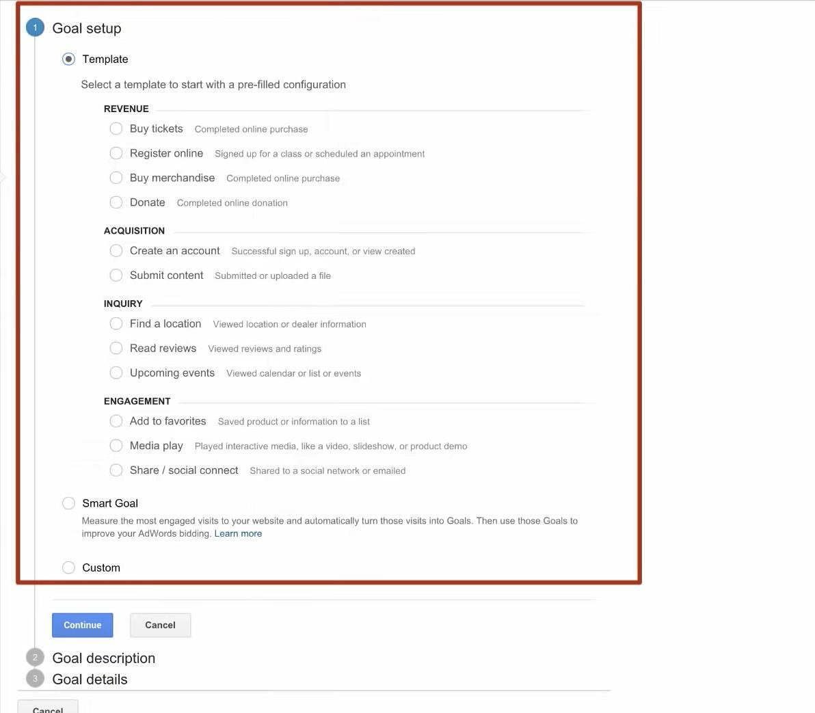
Goal setup

Slide 30
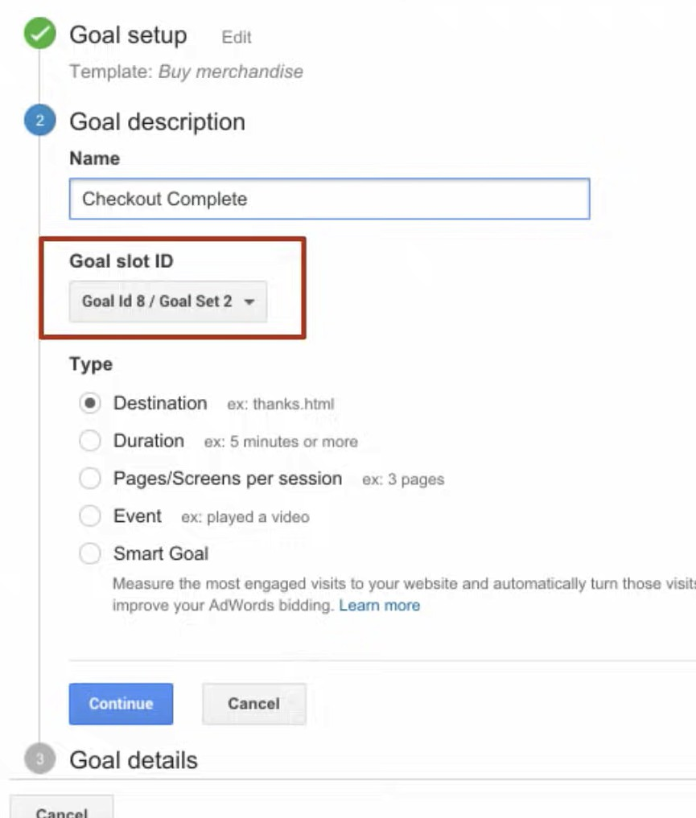
Goal setup

Slide 31
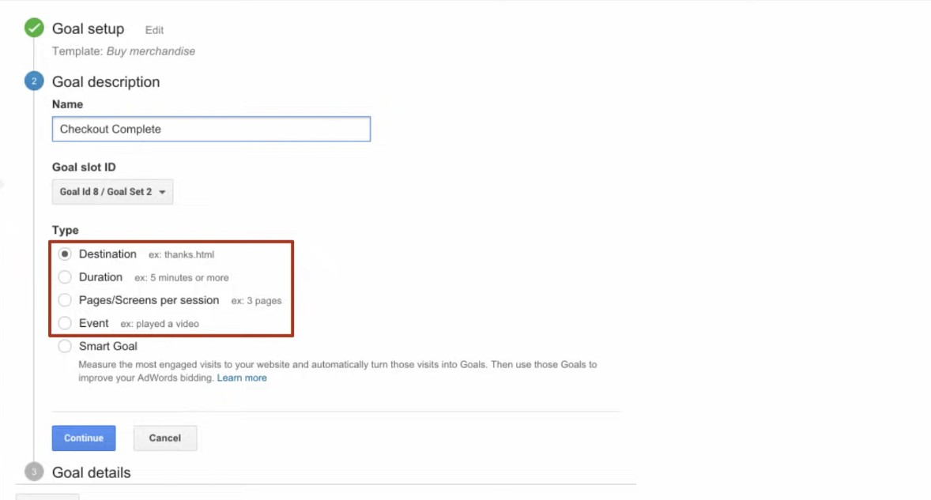
Goal setup

Slide 32

Event tracking
What is Event tracking?
Event tracking reports
Implementing event tracking
Event tracking best practices

Slide 33


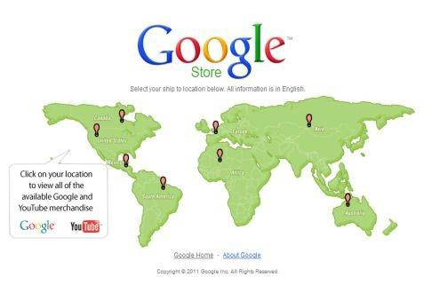
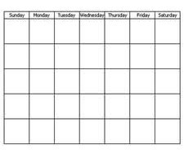

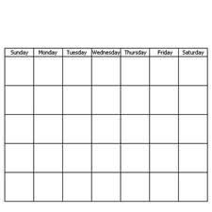

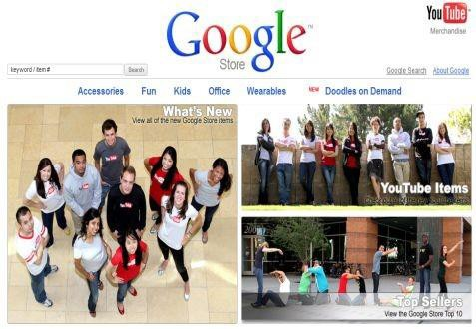
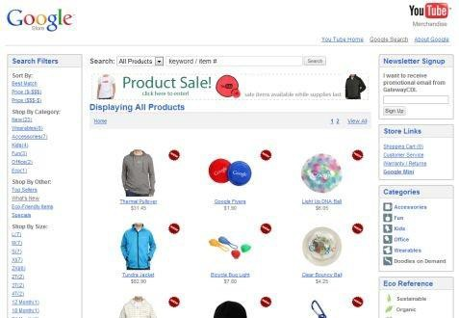
A single user
Let’s consider a
single unique user.
Each user can have multiple sessions on your site.
Multiple pageviews can occur during a single session.
User (IP: 74.12.123.123)
aPg eview (/)
aPg eview (/shop.axd/Home)
S ession (11:15-11:28am)
Session (5:10-5:24pm)
Pageview
Session (10:22-10:31am)
(/googlesearch.aspx…)

Slide 34
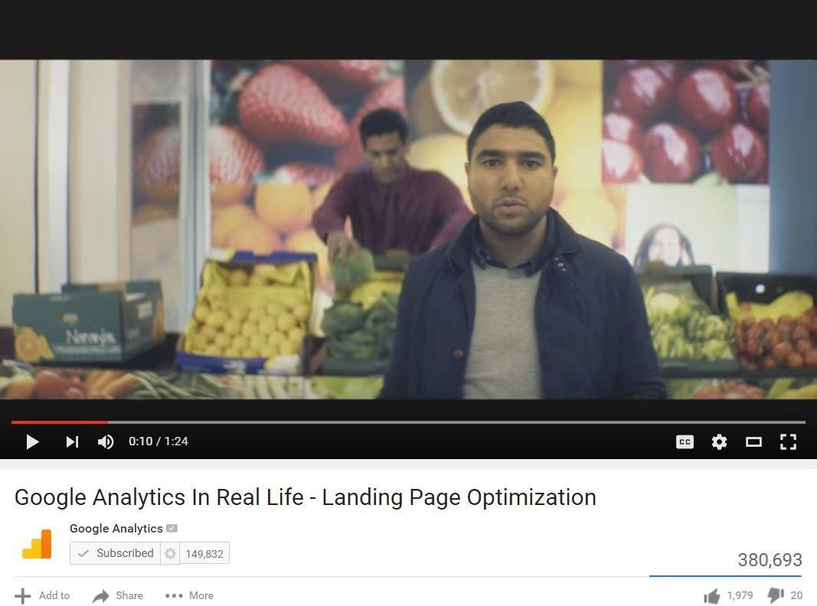
If GA tracks pageviews, how do we track stuff like this?

Slide 35
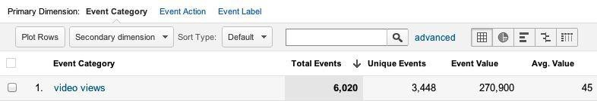

Interaction classiﬁcation
Optional
Category
Action
Label
Value

Slide 36
Any interaction at all can be an event
Category
Action
Label
Value
Video | Play | GAinRealLife | 50%
Video Video | FullScreen Finished | GAinRealLife GAinRealLife | 100%

Slide 37
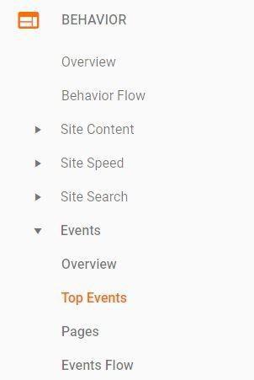
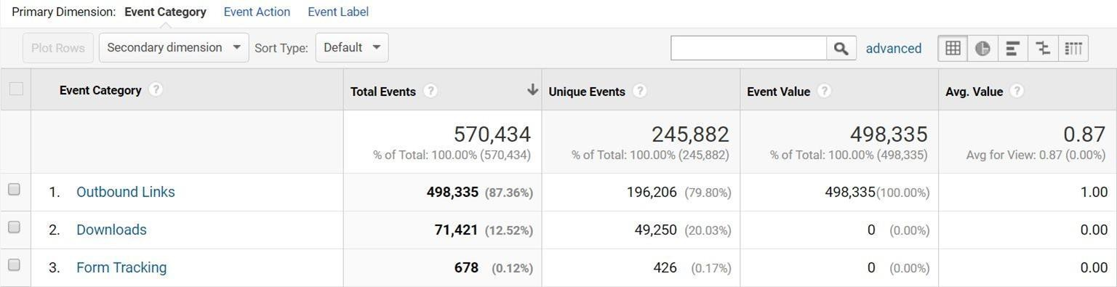
We start out at the category level
Introduction to Event Tracking

Slide 38
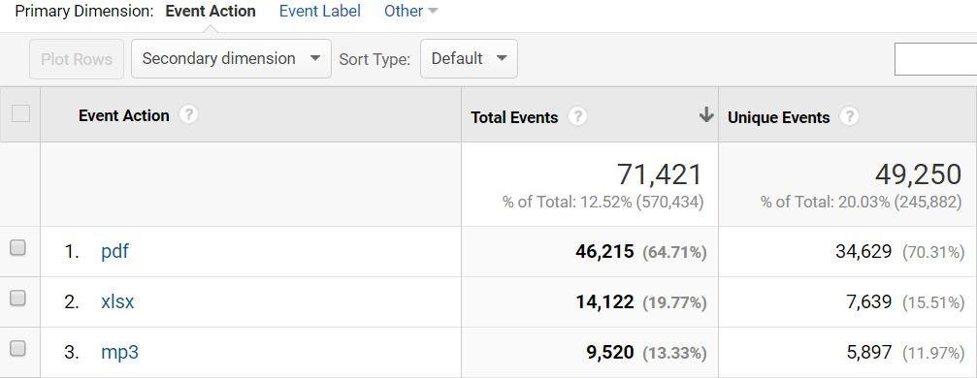
Drill into any category and you’ll see the
actions
Introduction to Event
Tracking

Slide 39
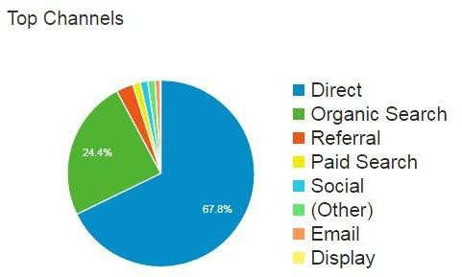
What kinds of trafﬁc are there in Google Analytics?

Slide 40
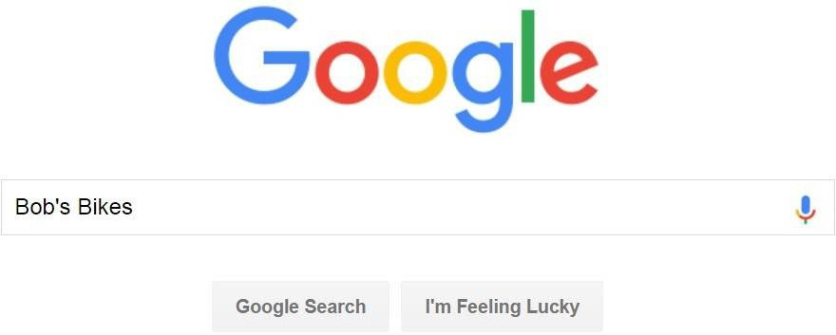
Each visit to your site has several attributes
Bob’s Bikes Website
Source | Medium | Campaign | Term | Content
google | organic | (none) | Bob’s Bikes | (none)

Slide 41

Each visit to your site has several attributes
Bob’s Bikes Website
Source | Medium | Campaign | Term | Content
bing | organic | (none) | Bob’s Bikes | (none)

Slide 42

Bob’s B www.b Shop N Receive
ikes Bike Sale - Free Shipping, Easy Returns bsbikesareawesome.com/FreeShipping/BigSale w For All The Latest Bikes. Order Today and 10% Off Today! |  |  |  |  | Bob’s Bikes Website
Source | Medium | Campaign | Term | Content
google | cpc | GA Training | awesome bikes | Google Analytics Training

Slide 43
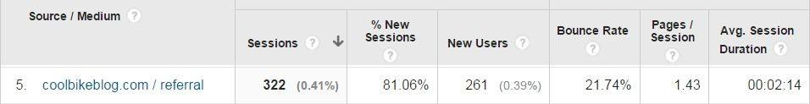
Cool Bike Blog
Bob’s Bikes Website
Source | Medium | Campaign | Term | Content
coolbikeblog.com | referral | (none) | (none) | (none)

Slide 44

Bob’s Bikes Website
Source | Medium | Campaign | Term | Content
direct | (none) | (none) | (none) | (none)

Slide 45

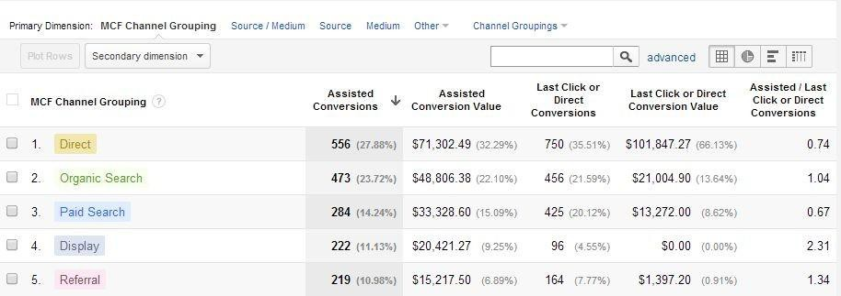
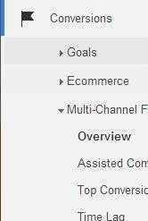
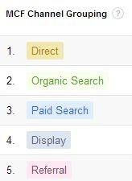

MCF reports

Slide 46
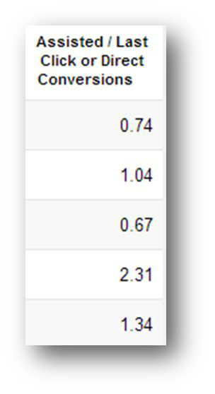
The “exposer-to-closer” ratio
Some channels are good at raising awareness; others, at making the sale.

Slide 47




Different channels behave differently
Some channels are good at raising awareness; others, at making the sale.

Slide 48



There are so many ways a user can get to your content…

Slide 49




There are so many ways a user can get to your content…

Slide 50








Attribution Context
Increasingly complex conversion paths introduce 3 challenges in measurement
Last Click Conversion
Generic Brand
Ad Click Ad Click
Brand
Ad Click
Challenge 1: Crediting Across Keywords
Challenge 2: Crediting Across Devices
Challenge 3: Crediting Across Channels

Slide 51





But how do we determine who gets credit in a situation like this one?

Slide 52
Answering this question is what we call attribution
Every web analytics solution uses at least one “attribution model” to answer this question. Let’s look at some different types of attribution models!
First-touch attribution
The ﬁrst known “touch-point” with the user gets full credit
No other sources get any credit at all!
Last-touch attribution
The ﬁnal “touch-point” with the user gets full credit
Similarly, no other sources get any credit

Slide 53
Visually, here’s what Last Click looks like
100%
C1 C2 C3 C4 C5
The Last Interaction model attributes 100% of the conversion value to the last channel with which the customer interacted before buying or
converting.
When it's useful: If your ads and campaigns are designed to attract people at the moment of purchase, or your business is primarily
transactional with a sales cycle that does not involve a consideration phase, the Last Interaction model may be appropriate.

Slide 54
Visually, here’s what Last Non-Direct click looks like
C1 C2 C3 C4 C5
The Last Non-Direct Click model ignores direct trafﬁc and attributes 100% of the conversion value to the last channel that the customer clicked through from before buying or converting. Analytics
uses this model by default when attributing conversion value in non-Multi-Channel Funnels reports.
When it's useful:
Because the Last Non-Direct Click model is the default model used for non-Multi-Channel Funnels reports, it provides a useful benchmark to compare with results from other models.
In addition, if you consider direct trafﬁc to be from customers who have already been won through a different channel, then you may wish to ﬁlter out direct trafﬁc and focus on the last marketing activity before conversion.

Slide 55
Visually, here’s what ﬁrst looks like
100%
C1 C2 C3 C4 C5
The First Interaction model attributes 100% of the conversion value to the ﬁrst channel with which the customer interacted.
When it's useful: This model is appropriate if you run ads or campaigns to create initial awareness. For example, if your brand is not well known, you may place a premium on the keywords or channels that ﬁrst exposed customers to the brand.

Slide 56
Linear attribution model
20% |  | 20% |  | 20% |  | 20% |  | 20%
S1 |  | S2 |  | S3 |  | S4 |  | S5
The Linear model gives equal credit to each channel interaction on the way to conversion.
When it's useful: This model is useful if your campaigns are designed to maintain contact and awareness with the customer throughout
the entire sales cycle. In this case, each touchpoint is equally important during the consideration process.

Slide 57
Time Decay model
50%
25%
15%
10%
0%
S1 S2 S3 S4
S5
If the sales cycle involves only a short consideration phase, the Time Decay model may be appropriate.
This model is based on the concept of exponential decay and most heavily credits the touchpoints that occurred nearest to the time of conversion.
The Time Decay model has a default half-life of 7 days, meaning that a touchpoint occurring 7 days prior to a conversion will receive 1/2 the credit
of a touchpoint that occurs on the day of conversion. Similarly, a touchpoint occurring 14 days prior will receive 1/4 the credit of a
day-of-conversion touchpoint. The exponential decay continues within your lookback window (default of 30 days).
When it's useful: If you run one-day or two-day promotion campaigns, you may wish to give more credit to interactions during the days of the
promotion. In this case, interactions that occurred one week before have only a small value as compared to touchpoints near the conversion.

Slide 58
Position-Based model
40%
40%
10%
10%
S1 S2 S3 S4
The Position Based model allows you to create a hybrid of the Last Interaction and First Interaction models. Instead of giving all the credit
to either the ﬁrst or last interaction, you can split the credit between them. One common scenario is to assign 40% credit each to the ﬁrst
interaction and last interaction, and assign 20% credit to the interactions in the middle.
When it's useful: If you most value touchpoints that introduced customers to your brand and ﬁnal touchpoints that resulted in sales, use
the Position Based model.

Slide 59

Time for a (very informal) quiz
So, which web analytics attribution model is best?
Equal (linear) distribution – it’s the most fair.
Time decay – the most recent touch-point should get the most credit, but not all of it.
I’m not sure, but now I’m getting nervous that my numbers could lie to me!
Tip:
The GA default is last-touch, but there’s no best model.
MCF gives us the ability to attribute value to all touch-points!

Slide 60


Building your own models

Slide 61




Custom models

Slide 62
Google Analytics Course project

